Slide 1
Viruses

Slide 2
How many lives did WWII claim?
An estimated 50 million lives were lost to the war but were all those lives a result of combat?
Lives taken as a result of combat was estimated at 16 million.
What claimed the lives of so many people?

Slide 3
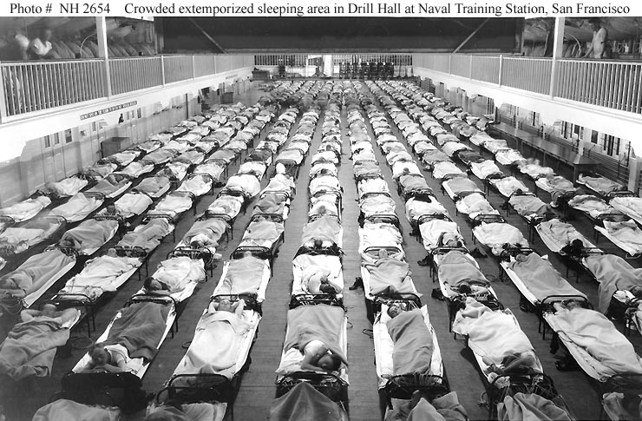
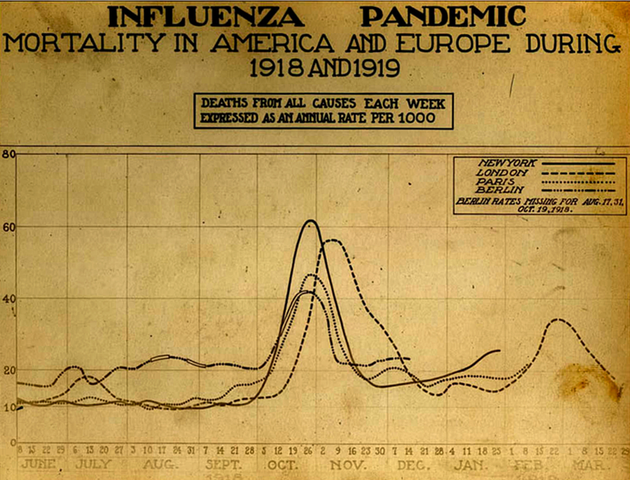
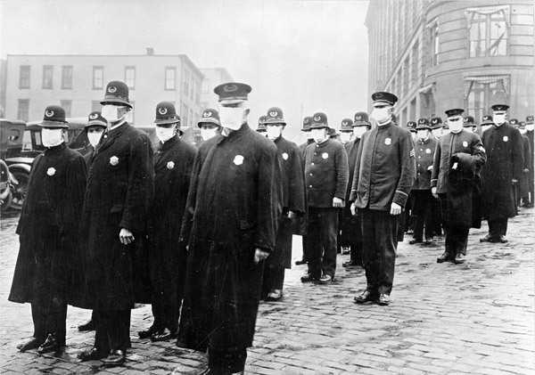
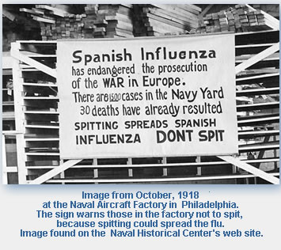
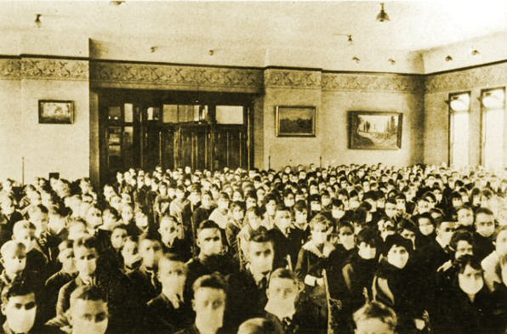
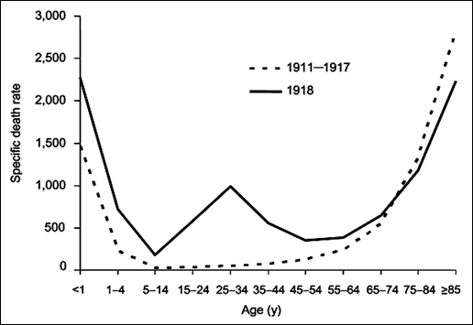
INFLUENZA

Slide 4
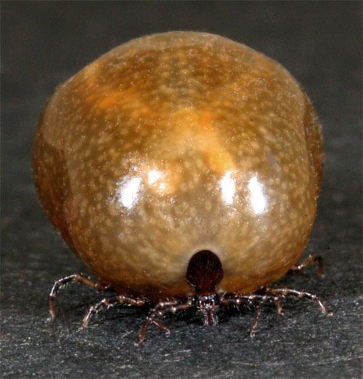
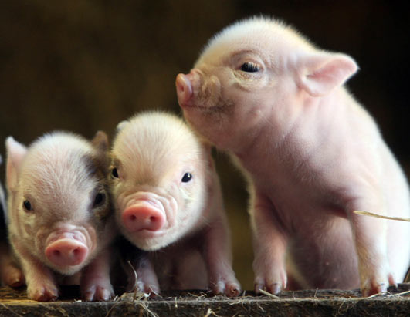
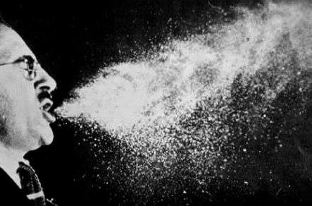
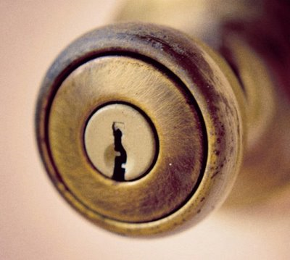
Transmission
100 mi/hr

Slide 5
Viruses
Nonliving strand of DNA or RNA
Covered by a protective protein coat called a capsid
Helps the virus attach to cells & helps the virus penetrate the host cell
Proteins and lipids CAN surround the capsid called a Sheath (envelope)
Helps the virus attach to cell surfaces
Helps virus enter the host cell
Contains cell derived & viral derived proteins
Notes:
Viruses usually classified by what genetic material is within the cells

Slide 6
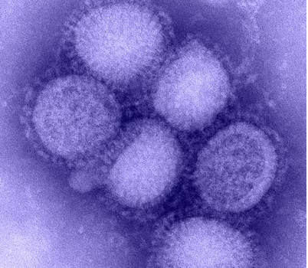
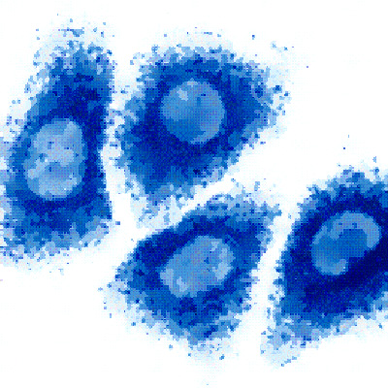
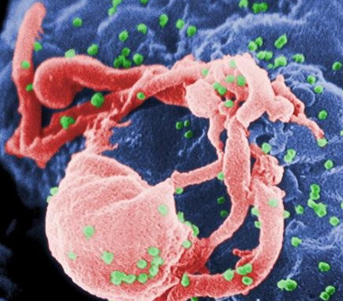
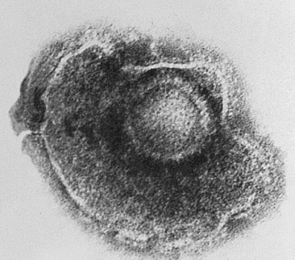
Herpes
H1N1
HIV
Varicella Zoster
Notes:
Herpes- cold sores, genital herpes
Varicella Zoster- chicken pox, shingles
HIV- aids

Slide 7
Not Living Because…
Can’t take in nutrients or use energy
Can’t replicate on their own
need a living cell in order to function (go through metabolism and produce proteins) and reproduce
Acellular- lack cytoplasm & cellular organelles

Slide 8
Virus Characteristics
Size- 300 nanometers (one billionth of a m); 1/10 the size of bacteria
Shape- rod (filament) or sphere
Nucleic Acid- either DNA or RNA (retroviruses)
Classification- based on the organisms they infect
Infects bacteria- Bacteriophage
Animal & plant viruses
Infection-
Virulent- causes symptoms immediately
Temperate- doesn’t cause symptoms immediately
Notes:
Retrovirus- HIV

Slide 9
Viral Infection
To replicate: virus enters host cell
How it does this:
Attaches to host cell receptors on the plasma membrane of the host
Organisms have different receptors (many viruses can’t be transmitted between species)
Virus releases genetic material into the cytoplasm of the host (capsid breaks down)V

Slide 10
Two Cycles
Lytic Cycle
Virus takes control of cell functions & uses the host cell to replicate
The cell bursts killing the host cell, and releasing the new viruses
Lysogenic Cycle
Viral DNA is slipped into the host cell’s DNA
Virus lays dormant in the cell as the cell reproduces
Lytic Cycle is eventually activated bursting and killing the host cell

Slide 11
Lytic Cycle
Virus takes control of cell functions & uses the host cell to replicate
Bursts and kills the host cell, releasing the new viruses
Phases of the Lytic Cycle:
Virus attaches itself to the cell
Penetration: enzymes weaken the cell wall & DNA or RNA is injected, leaving the empty capsid outside the cell.

Slide 12
Lytic Cycle Cont…
Replication: Viral DNA or RNA takes control of cell activity & makes more viral parts.
Assembly: The host cell is directed to assemble the new viruses.
Lysis: Host cell breaks open, releasing the new viruses by exocytosis to infect other cells
Causes active infections

Slide 13
Bacteriophage
Lytic
Cycle
5. Lysis
4. Assembly of new viruses
1. Attachment
2. Penetration
3. Viral DNA
Replication

Slide 14
Lysogenic Cycle
Viral DNA is slipped into the host cell’s DNA
Virus is dormant in a cell as the cell reproduces
The virus attaches itself to the host cell.
The virus injects its DNA into the cell

Slide 15
The viral DNA becomes a part of the host cell’s DNA, becoming a new set of cell genes called a provirus.
When the host cell divides, this new gene (provirus) is replicated in each of the new cells. Every new cell made will carry the viral DNA.
Later, a stimulus may activate it to the lytic cycle.
Notes:
Like miniature time bombs- passed onto cells,

Slide 16
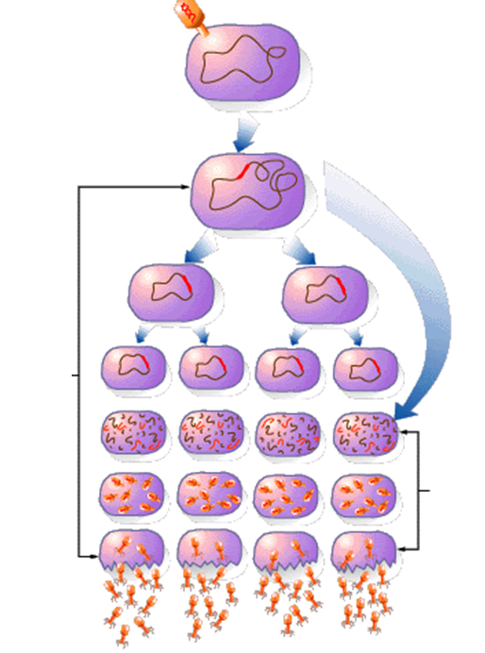
Virus attaches to host cell and injects DNA into cell
Cell reproduces w/ viral DNA
Lysogenic Cycle
Lytic Cycle

Slide 17
Why can’t antibiotics be used against viral infections?
Viruses are parasites using host cell to reproduce
Antibiotics targeting bacterial cells don’t kill human cell & thus don’t harm the virus inside
Viruses can be prevented using a vaccine
A weakened/ dead pathogenic cells that stimulates antibody production

