Slide 1
Transcription and Translation

Slide 2
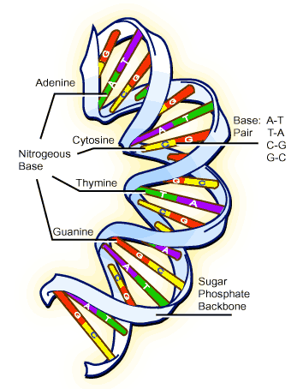
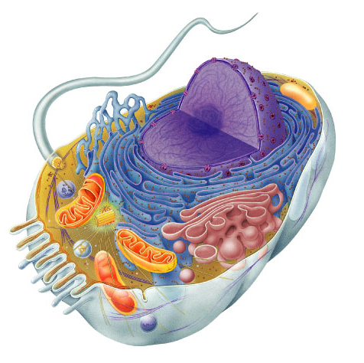
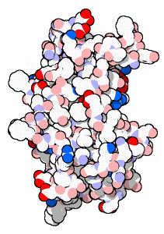
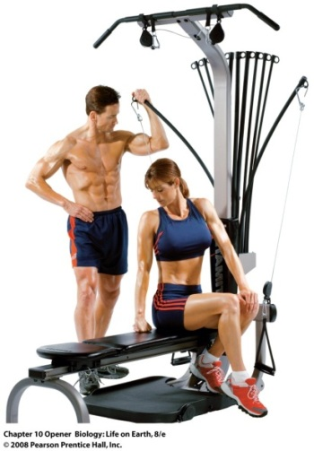
DNA → Proteins → Cells → Bodies
Bodies are made up of cells
  All cells run on a set of instructions or CODES spelled out in DNA (read every 3 bases- codon)
Protein synthesis- using the information from our DNA to build proteins
DNA gets all the glory,
Proteins do all the work

Slide 3
What do we know?
DNA
  Is in the nucleus, want to keep it there so it is protected
Proteins
  Made at ribosomes
  Control rate of reactions and regulate cell processes
  Important cell structures
  Code for specific physical and behavioral traits
.
Need to get DNA information outside of the nucleus using a messenger

Slide 4

nucleus
cytoplasm
DNA
Proteins
Transcribed
Translated

Slide 5
Class Question:
What does it mean to transcribe something? What does it mean to translate something?

Slide 6
Transcribe
to make a written copy
to make an exact copy of (a document, text, etc.).
Translate
to turn from one language into another
to change the form, condition, nature, etc.
to explain in terms that can be more easily understood; interpret.

Slide 7
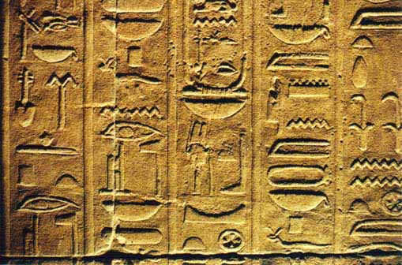

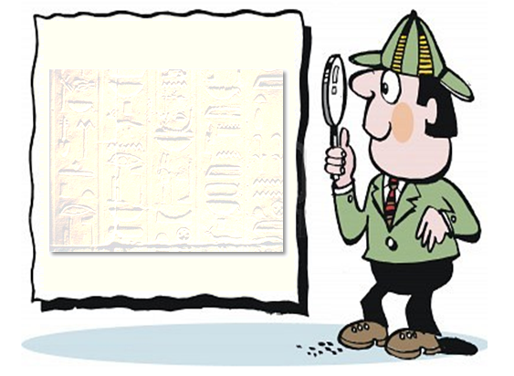
King Tut had a butt what color was it?

Slide 8
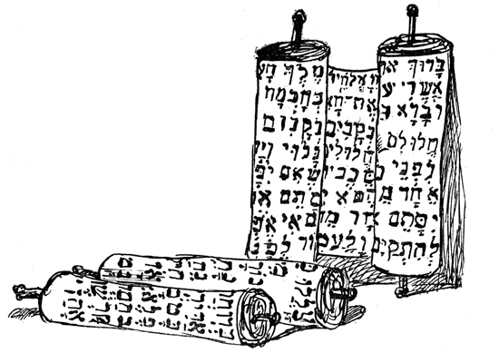


Notes:
2,018 languages

Slide 9
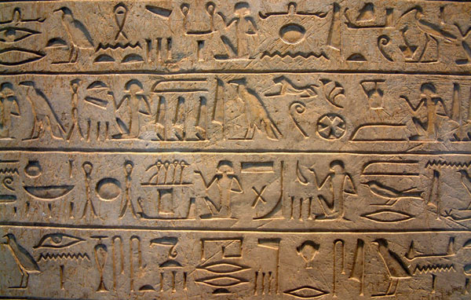
Modeling Protein Synthesis!

Slide 10
Genes & Protein Synthesis
Protein Production occurs in 2 steps:
  Step 1 (transcription): Sequence is copied from DNA into RNA in the nucleus
  Step 2 (translation): RNA is translated into instructions that direct protein production in the cytoplasm… this determines an organism’s characteristics
Transcription
Translation
DNA -------> RNA -------> Protein

Slide 11
Who is the messenger that decodes DNA?
  messenger RNA
nucleus
cytoplasm
DNA
Proteins
Transcribed
Translated

Slide 12
Types of RNA involved in Protein Synthesis
Role of RNA- controls assembly of amino acids into proteins
  Messenger (mRNA)- carries the “blueprint” for protein assembly from the nucleus to the ribosome
  Transfer (tRNA)- brings the correct amino acid to the ribosome and pairs up with an mRNA code for that amino acid building protein
  Ribosomal (rRNA)- hold ribosomal proteins in place

Slide 13
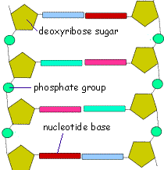
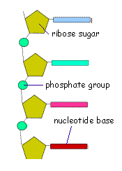
Difference between DNA & RNA
DNA
RNA
Sugar= deoxyribose
Double stranded
Thymine
Sugar- ribose
Single stranded
Uracil

Slide 14
Matching bases of DNA & RNA
DNA must be transcribed into RNA
Just like replication except U instead of T is matched to A
DNA
TACGCACATTTACGTACGCGG
mRNA
AUGCGUGUAAAUGCAUGCGCC

Slide 15
Transcription of DNA into RNA
Transcription differs from replication in 3 ways:
  Only one region of one DNA strand is used as a template
  RNA polymerase is used instead of DNA polymerase
  RNA is single stranded & DNA is double stranded

Slide 16
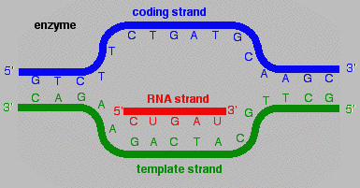
How Transcription Begins…
1. Begins when RNA polymerase binds to a promoter region
  Promoter- base sequence at the start of a gene (TATAAAA region)
2. RNA polymerase attaches to the DNA & unwinds the double helix (creating a bubble)
Notes:
RNA transcript results
Promoter- TATAAAA

Slide 17
How Transcription Begins…
3. RNA polymerase moves along the DNA template in a 5’-3’ direction to the end of a gene
Notes:
RNA transcript results

Slide 18
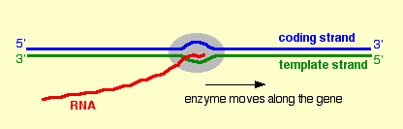
How Transcription Begins…
4. A termination sequence of bases stops RNA polymerase & the mRNA transcript detaches from the DNA template
Notes:
RNA transcript results

Slide 19
Double stranded DNA unzips
T
G
G
T
A
C
A
G
C
T
A
G
T
C
A
T
C
G
T
A
C
C
G
T

Slide 20
Match RNA bases to DNA bases
A
C
U
G
G
A
U
G
U
C
U
C
G
A
A
C
U
A
G
A
C
U
A
RNA
polymerase
G
A
C
C
T
G
G
T
A
C
A
G
C
T
A
G
T
C
A
T
C
G
T
A
C
C
G
T

Slide 21
Finishing Touches on mRNA
Transcripts:
Newly formed mRNA is unfinished & is modified before leaving the nucleus
  Noncoding portions (Introns) are cut out
  Coding regions (Exons) are put together to produce the final transcript forming the mRNA strand
mRNA now leaves the nucleus
& enters the cytoplasm

Slide 22
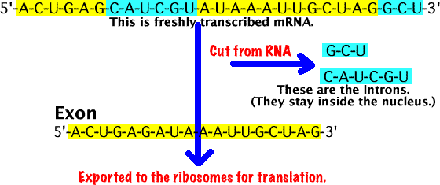
Introns & Exons

Slide 23
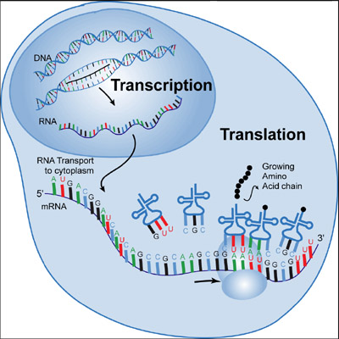

Slide 24
Summary
Transcription- Nucleus
  RNA polymerase uses DNA template to make mRNA
    Starts at promoter region (TATAAAA Box)
    Ends at termination sequence
  Introns are removed from mRNA before leaving nucleus

Slide 25
From mRNA to Proteins
Every 3 bases (triplet) on mRNA (codon) specifies an amino acid into a growing polypeptide chain (chain of protein)
    61 codons- code for amino acids
    3 codons- code to stop protein synthesis
    1 codon- codes to start protein synthesis (AUG- methionine)

Slide 26

How Translation Begins…
1. mRNA enters the cytoplasm and attaches to a ribosome (AUG initiates the process)
2. mRNA is read by its codons as it passes through the ribosome (feeds between a small & large subunit)

Slide 27
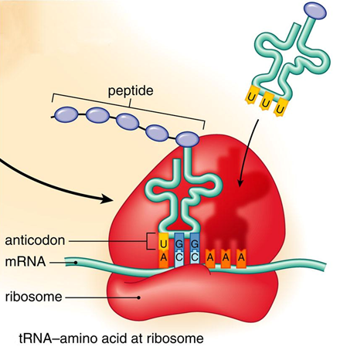

Slide 28
How Translation Begins…
3. As the mRNA feeds through the ribosome, the mRNA codon has a complementary tRNA anticodon
4. tRNA anticodon carries one specific amino acid… thus putting the correct amino acid into place forming a protein

Slide 29
How Translation Begins…
5. Translation stops when a stop codon is reached
  UAG
  UAA
  UGA

Slide 30
Summary
Transcription- Nucleus
  RNA polymerase uses DNA template to make mRNA
    Introns are removed from mRNA before leaving nucleus
Translation- Cytoplasm
  Begins w/ start codon, mRNA attaches to a ribosome
  mRNA is read by its codons- tRNA anticodon binds to the mRNA codon
  tRNA anticodon carries appropriate amino acid
  Amino acids join to produce protein

Slide 31
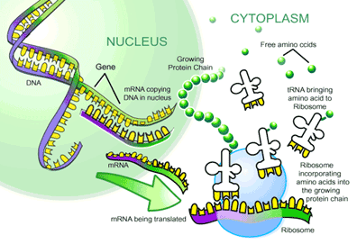

Slide 32
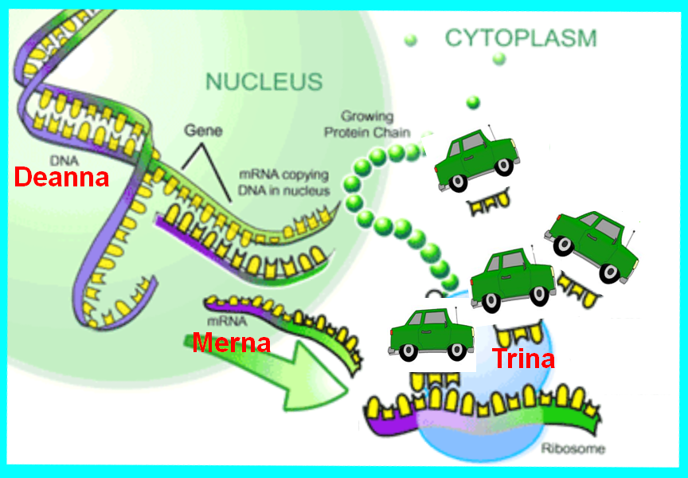
Parking
Lot

Slide 33
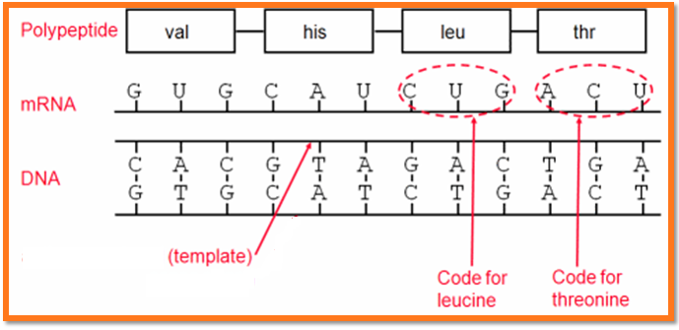
Protein: The End Result
a.a. sequence → protein shape → protein function
http://www.youtube.com/watch?v=41_Ne5mS2ls&feature=related

Slide 34
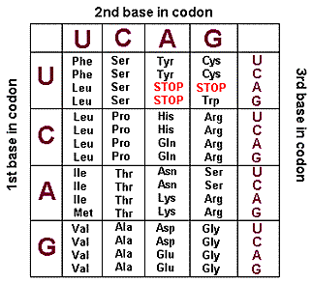
Quick DEMO
A certain gene has the following base sequence:
GACAAGTCCACAATC
Determine what the mRNA and tRNA sequence
Determine the protein chain

Slide 35
Transcription/Translation Practice
Each column in the table below represents three nucleotides. Within each column, fill in the cells that are blank.
DNA Strand | TAC |  |  | GGG
mRNA |  |  |  |  | CCU
tRNA |  | UCG
Amino Acid |  |  | Leu

Slide 36
Transcription/Translation Practice
DNA Strand | TAC | TCG | AAT GAG AAC GAT GAA GAC | GGG | GGA
mRNA | AUG | AGC | UUA CUC UUG CUA CUU CUG | CCC | CCU
tRNA | UAC | UCG | AAU GAG AAC GAU GAA GAC | GGG | GGA
Amino Acid | MET | SER | Leu | PRO | PRO

