Slide 1
Cell Size

Slide 2
Limits to Size
A cell can not continually grow.
The larger a cell becomes…
The less efficient it is in moving nutrients and waste materials across the cell membrane
Notes:
DNA contains the genetic blueprints for protein synthesis. All organelles of the cell require proteins to function; therefore, an increase in cell size would require an increase in DNA and protein synthesis to accommodate the extra organelles.

Slide 3
Exchanging Materials
Nutrients enter a cell through its cell membrane & waste products leave the same way
The rate this occurs depends on the SA of the cell.
The rate at which food/ materials are used up & waste is produced depends on the cell’s volume.
Notes:
A cell 20 cm would require months to get the nutrients it needs

Slide 4
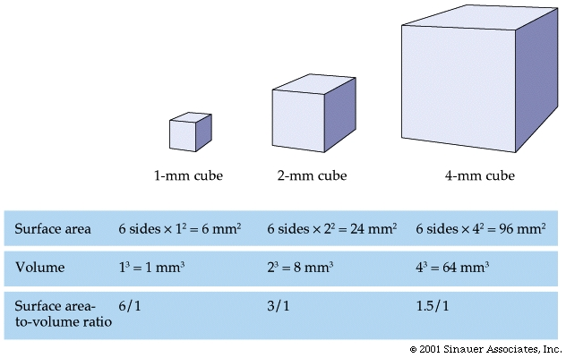

Slide 5
