Slide 1
Organelle Functions

Slide 2
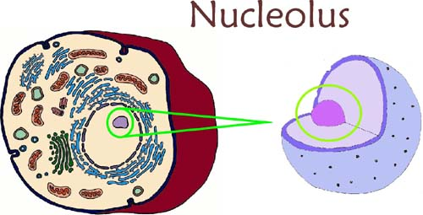
Nucleolus
Ribosomes are synthesized here and then migrate to cytoplasm

Slide 3
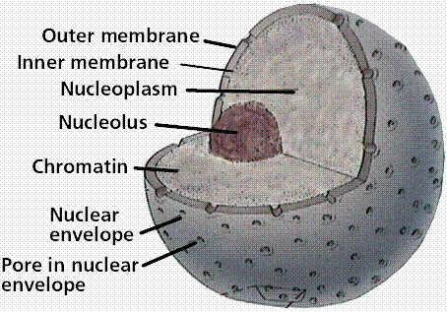
Nucleoplasm
Helps maintain the shape and structure of the nucleus

Slide 4
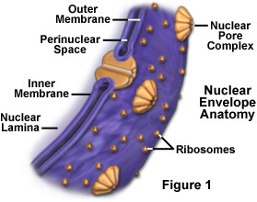
Nuclear Membrane
Protects the nucleus from the cytoplasm
Selectively Permeable- controls what material moves in and out of the cell

Slide 5
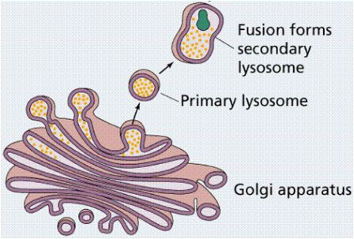
Lysosome
Form in the Golgi Apparatus
Breaks down food
Recycle older organelles
Return digested components to cytoplasm to be reused

Slide 6
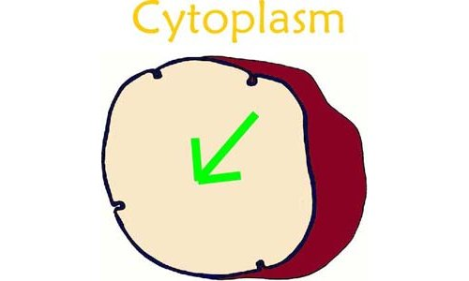
Cytoplasm
Fills the space between the nucleus and the cell membrane.
Fluid portion is called the cytosol and is mainly water.
Site of most cell activity (transports materials through out the cell).

Slide 7
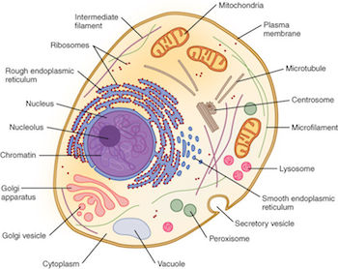
Microtubules
Network of proteins that give the cell support
Found in the cytoplasm
Gives the cell its shape and mobility

Slide 8
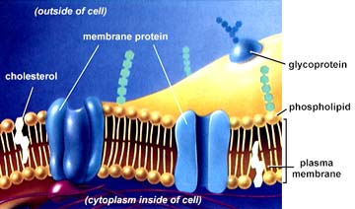
Cell Membrane
Protects the cell from the outside environment
Selectively Permeable- controls what material moves in and out of the cell
Acts like a gatekeeper

Slide 9
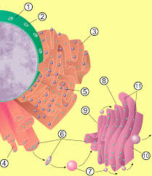
Golgi Apparatus
Condensed membrane-enclosed spaces that process, sort and deliver proteins created in the ribosomes on the ER

Slide 10
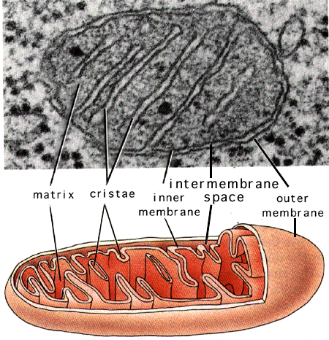
Mitochondria
Converts the nutrients the cell intakes to usable energy
It is folded and kidney bean shaped

Slide 11
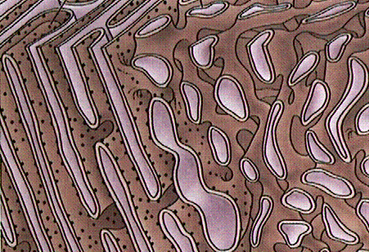
Smooth ER
Lacks Ribosomes
Acts as a storage area for proteins exiting the cell

Slide 12
Rough ER
Contains Ribosomes
Transport Proteins in and out of the nucleus.

Slide 13
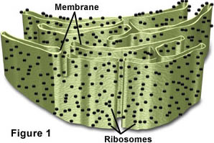
Ribosome
The place where RNA (transcribed from DNA) is translated to produce protein

Slide 14
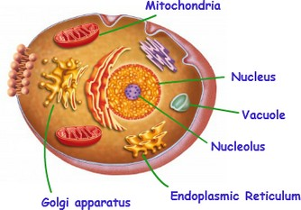
Nucleus
Control center of the cell and contains the cell’s DNA

Slide 15
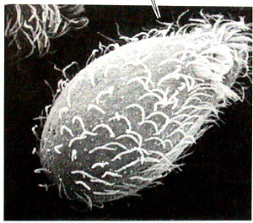
Cilia
Move liquid and objects past the surface of the cell

Slide 16
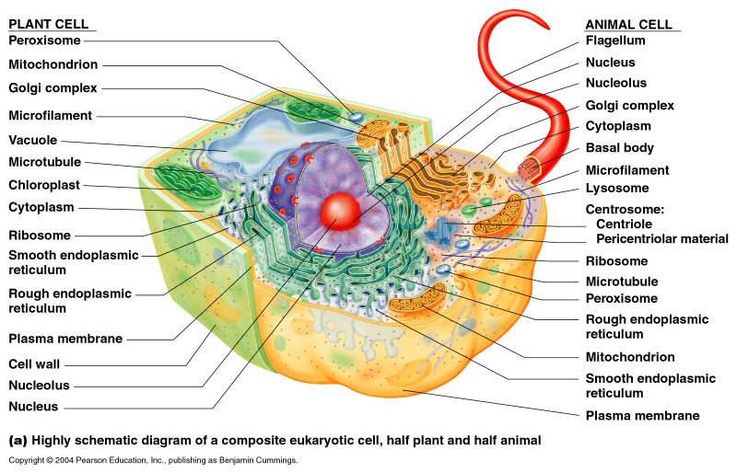
Flagella
Allows the cell to be mobile
Provides locomotion

Slide 17
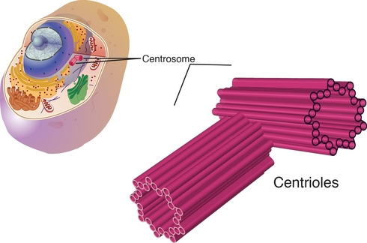
Centriole
Used in cell division
Help in the formation of spindle fibers that separate chromosomes during cell division

Slide 18
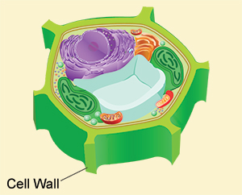
Cell wall
Helps maintain the shape of the plant cell
Supports and strengthen plants
Made of cellulose

Slide 19
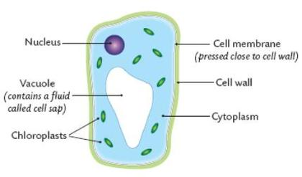
Vacuole
Often the largest organelle found in plant cells
Holds materials and wastes
Maintains the proper pressure within the plant cells

Slide 20
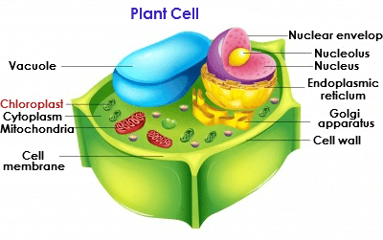
Chloroplast
Convert light energy of the Sun into sugars that can be used by cells

Slide 21
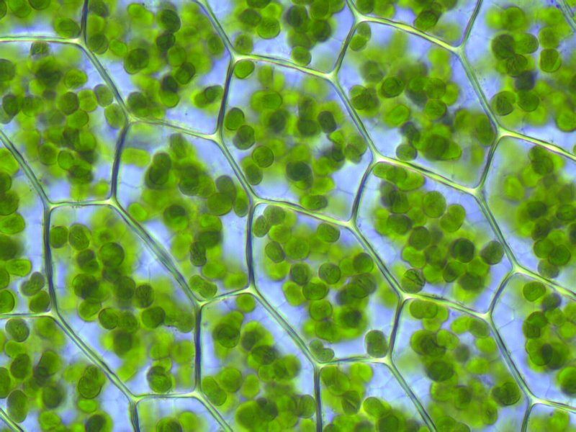
Chlorophyll
Vital for photosynthesis
Green in color and allows the plant to absorb energy from light

Slide 22
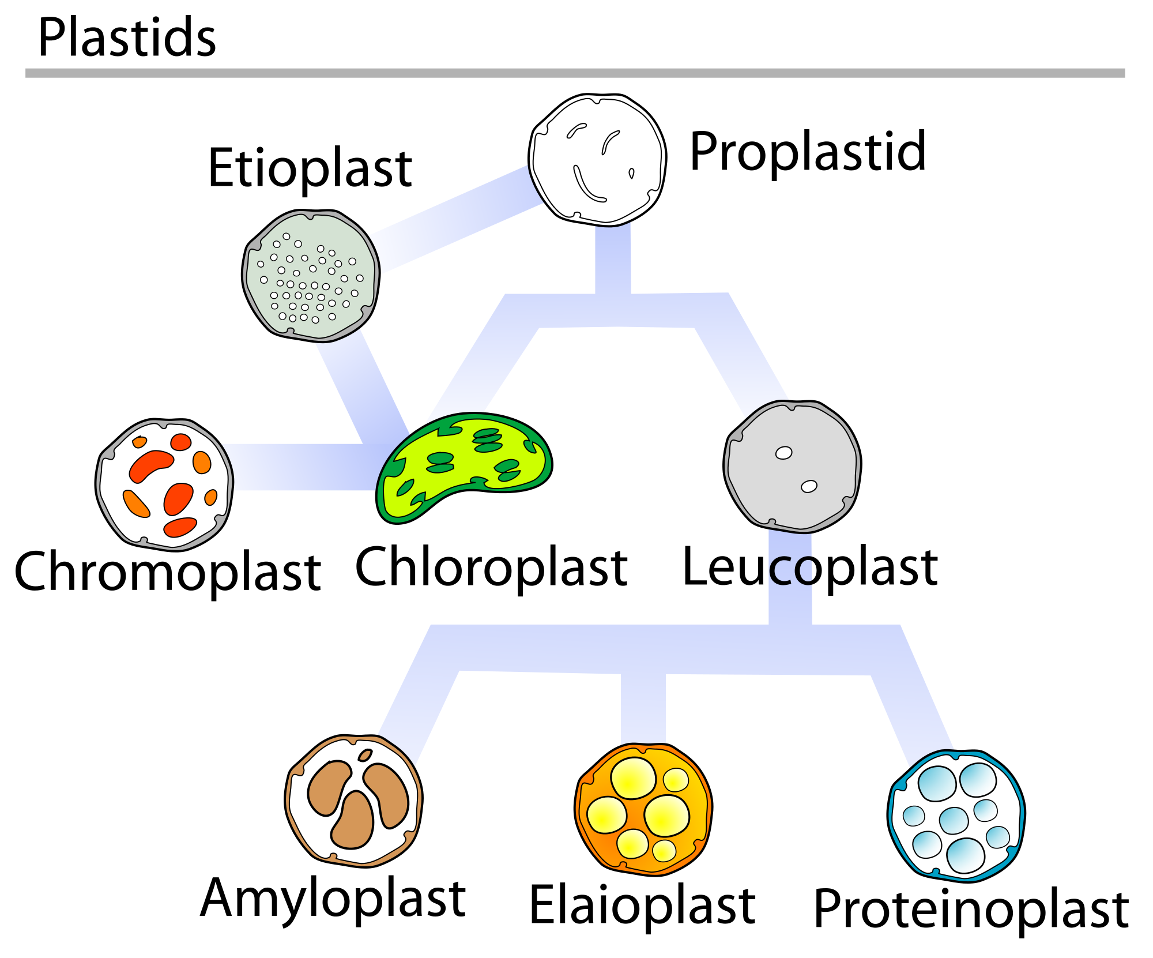
Plastid
Site of manufacture and storage of important chemical compounds used by the cell

