Slide 1
Nature of Science
Notes:
When you look at information… how do you determine whether or not is it scientific or not scientifice?

Slide 2
Knowledge Claim Statements
Better stock market decisions are made when the planets Venus, Earth, and Mars are aligned.
Atoms are the smallest particles of matter that exist.
Albert Einstein is the greatest physicist of the 20th century!
If you break a mirror, you will have seven years of bad luck.
The earth is flat. Anybody can see that!
All living things are composed of one or more cells.
Taking Vitamin C will prevent the common cold. Linus Pauling, who discovered the structure of Vitamin C says it does.
The rate of acceleration of all falling objects on earth is constant.
Notes:
Do individually, then discuss as a group and try to come up with an agreement as to where all the statements should lie

Slide 3
Least Scientific
Most Scientific
Notes:
What criteria do you use to judge where the statements were placed along the continuum? Based on how we define, interpret, and use science.
* Draw your continuum on the desk top

Slide 4
Least Scientific
Most Scientific
C.
A.
G.
B.
F.
D.
H.
E.
Notes:
Where you placed these statements may be a result of personal bias, your understanding and definition of science, may be based on historical, cultural or social influences, may be based on the process of testing this information

Slide 5
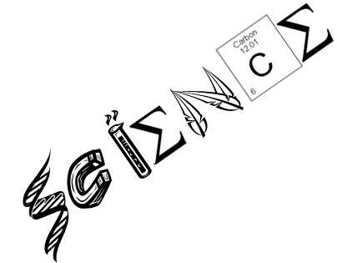
Define
for me…
Notes:
Process- certain rules must be followed but there is no one “scientific method” contrary to what we are taught in our textbooks.
Natural world- we can only test the natural world
* Write words that apply to science on table

Slide 6
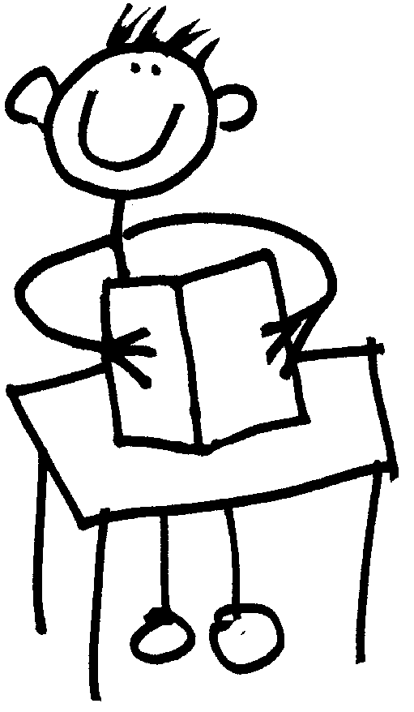
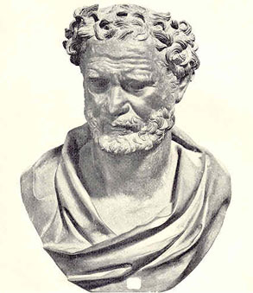
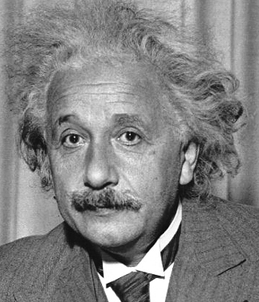
A set of procedures by which hypotheses are generated & tested
A way of questioning the truthfulness of what we know
A body of scientific information

Slide 7
Accepted Definition
The process by which we try to understand how the natural world works and how it came to be that way.

Slide 8
Directions
Each group will receive an envelope containing 16 checks. When directed, remove 4 of the checks from the envelope.
By observing the checks, your group must formulate a hypothesis explaining the events in the life of the person who wrote them .
Note: I don’t want you to simply record what the check was written for, or the date in which it was written.

Slide 9
Directions
When directed remove 4 more checks from the envelope and use this information to formulate a second hypothesis.
Remove 2 more checks and create a third hypothesis.
Choose a spokesperson to present the group’s final hypothesis to the class.
Hypothesis 1:
Hypothesis 2:
Hypothesis 3:
Hypothesis 1:
Hypothesis 2:

Slide 10
By not allowing you to see all the checks, what does this reveal about science?
1. Scientists never have all the information they need
Scientists use observations (made w/ the 5 senses) to make inferences (logical conclusions)
The “best” explanation for the moment is based upon existing data= hypothesis
Not all hypotheses stand the test of time

Slide 11
I don’t know the exact story of this individual, what does this reveal about science?
2. Science can’t be proven!
Can’t control every variable or test every aspect of phenomenon
If an idea stands the test of time, it is more likely an accurate explanation
3. Scientific methods can’t answer all questions
Goal of science= to provide natural explanations for events in the natural world
Those explanations are used to understand patterns in nature & to make predictions about natural events
Notes:
It is impossible to know if we have observed every possible aspect of a phenomenon or have controlled every possible variable. Scientific knowledge is contingent knowledge rather than absolute- in the past, there are numerous examples of scientific knowledge changing. If an idea survives testing, then it is stronger, and more likely an accurate explanation.

Slide 12
How did your story change each time you drew new checks? What made your story change?
4. Science is durable but tentative when new information is discovered
Durable- scientific conclusions are valuable and long lasting
Hypotheses→ Theories (Explain how natural phenomenon occurs)
Theories → Laws (Describes a natural phenomenon)
Tentative- scientific conclusions are subject to change
New discoveries may show previous hypotheses as incorrect
+

Slide 13
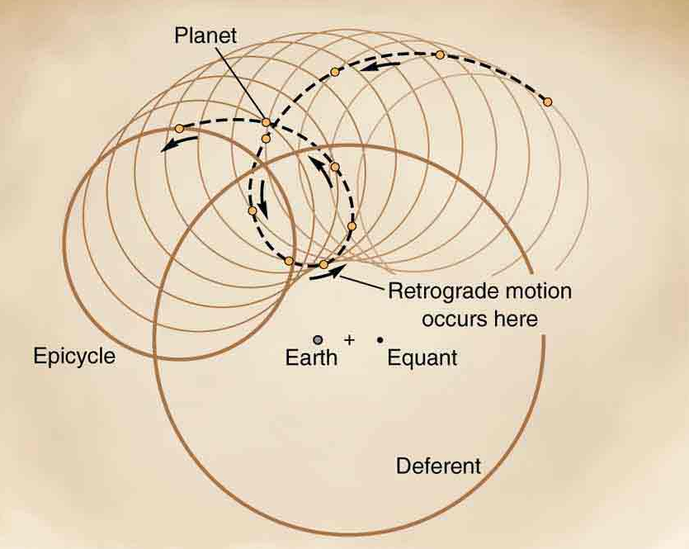
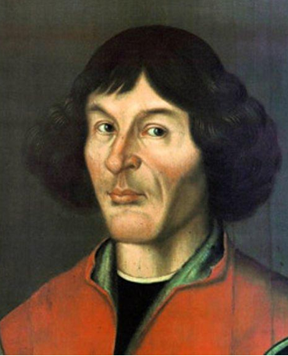
Past Theory:
Ptolemy &
Geocentrism
Accepted Theory:
Copernican Heliocentrism
Notes:
Geo- Greek meaning for earth; centri- center ; ism- act, state or theory of
Helio- means sun; centr- center; ism – the theory of

Slide 14
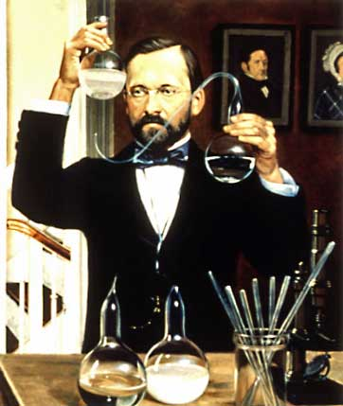
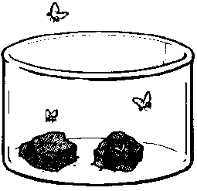
Spontaneous Generation
Maggots came spontaneously from rotting meat?
Louis Pasteur
Notes:
Redi (meat in open and non-open flasks) 1668, Needham (boil and then transfer) 1745, Spallanzani (boil & no exposure to air), Pasteur 1859(airborn microorganisms settled in bend of flask because of gravity)
Before microscopes and theories of cells and germs, man had other ideas about the creation of living things. He bizarrely believed that life arose from inanimate matter (for example, maggots come spontaneously from rotting meat). Proponents of this view (virtually everyone) used the Bible as a source of evidence, due to the fact that God made man from dust. However, the view did exist before Christianity and Aristotle said, in no uncertain terms, that some animals grow spontaneously and not from other animals of their kind. Earlier believers had to come up with some pretty strange ideas to make their theory work: Anaximander (a Greek philosopher who taught Pythagoras) believed that at some point in man’s history, humans had been born from the soil spontaneously in adult form, otherwise they could never have survived. Before we laugh too hard at the ancients, we should note that many Scientists right up to the 19th century believed this, and some even wrote recipe books for making animals. One such recipe (to make a scorpion) calls for basil, placed between two bricks and left in sunlight. The theory was not finally put to rest until 1859, when Louis Pasteur proved it wrong once and for all.

Slide 15
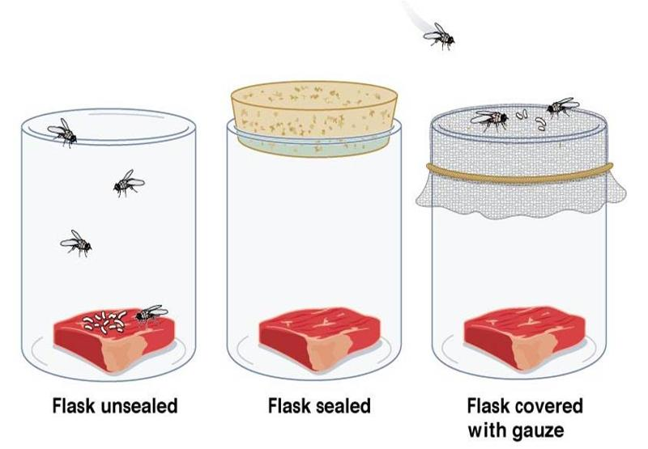
Maggots from flies
Redi 1668

Slide 16
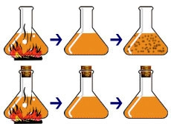
Microorganisms from the air
Needham 1745
Spallanzi 1745

Slide 17
How did you interpret and use observations to come to your conclusions?
5. Science is Empirical
Meaning that science is based on observation, experience, and experimentation that can be reproduced
Notes:
Observations are confined to the biological limits of our senses, even with technological advancement. Experiments are done to study cause effect relationships in the natural world.

Slide 18
How did your prior knowledge affect your inferences?
6. Science has a subjective element
Two scientists looking at the same data may see and respond differently based on prior experiences and beliefs
Science community employs a system of checks and balances→ peer review
Notes:
There are historical, cultural, and social influences on science. When we are interpreting and testing scientific claims we follow aspects of the scientific method; this is intended to make the process as objective as possible. The mental processing of our sensory information is unconsciously influenced by previous experiences, which may result in inaccurate or biased perceptions of the world.
Science is a human endeavor and can be done poorly however, the scientific community interpreting the best available evidence decides what is good science (it is not a public opinion poll).
Research is carefully reviewed by colleagues, who make critical comments and suggestions, and recommend the work for publication or rejection. Published works are open to the scientific community whereby the logic and reasoning can be evaluated, and procedures and results can be tested by additional observation and experimentation. Published scientific work provides a system of checks and balances. This allows work to ideas to be disproved, falsified, or modified.

Slide 19
What scientific attitudes led to your conclusion?
7. Good scientists share scientific attitudes:
Curiosity
Skepticism
Open-mindedness
Creativity

Slide 20
EXIT TICKET
F
F
__ Experiments are carried out to prove cause and effect relationships.
__ Science is completely objective.
__ Scientific ideas are tentative and can be modified or disproved, but never proved.
__ All scientific ideas are discovered and tested by controlled experiments.
__ Science can discover absolute truth.
__ Science relies on empirical evidence.
__ All scientists are prone to personal bias.
__ Every scientific theory is subject to revision if new data becomes available.
T
F
F
T
T
T
Notes:
1. F, 2. F, 3. T, 4. F., 5. F, 6. T, 7. T, 8. T

