Slide 1
Mitosis

Slide 2
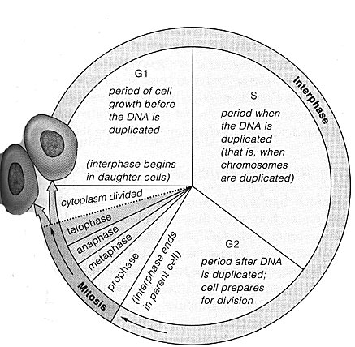
Cell Cycle of Eukaryotes

Slide 3
Interphase
The Different Phases…
G₁ | S | G₂ | G₀
First stage where cells grow to mature size; organelles duplicate | Chromosomes duplicate forming sister chromatids (Cell has 2x the amount of DNA it started with) | Cell grows & prepares for cell division (shortest phase) | Some cells stop maturing & enter this phase

Slide 4
Mitosis
Produces two daughter cells that are identical to the parent cell
Will have the same number of chromosomes
Division allows multi-cellular organisms to grow and repair damaged tissue

Slide 5
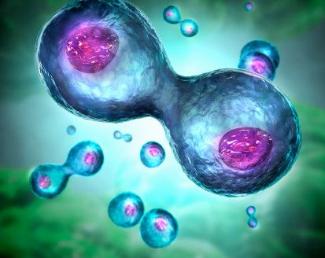
Mitosis:
Makes more cells!
Begin with one cell, end with two!

Slide 6
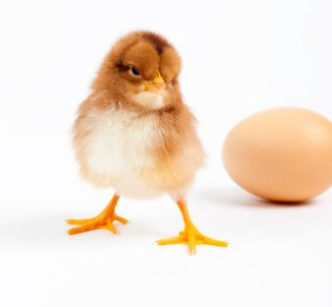
Mitosis:
Essential for growth and repair of plant, animal and human tissue.
Mitosis will help me grow!

Slide 7
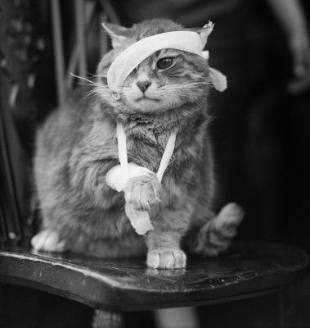
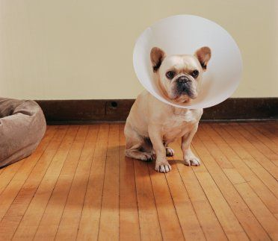
Mitosis will heal my wounds.
The sooner mitosis happens… the sooner my cone is removed!

Slide 8
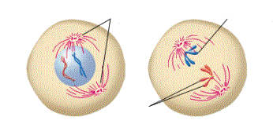
Prophase
Spindle Poles
Sister Chromatids
Sister Chromatids
Longest phase
Sister chromatids tighten into coils & are held together by a centromere
Nuclear membrane disappears
Centrosomes move to opposite poles
Made of organelles called centrioles
Spindle fibers extend from the centrioles

Slide 9
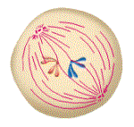
Metaphase
Spindle fibers attach to the centromere of sister chromatids and move them to the center (equator) of the cell

Slide 10
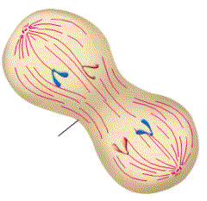
Anaphase
Sister chromatids of separate at the centromere & move to opposite poles
When chromatids separate, they are now considered individual chromosomes
Cleavage
Furrow

Slide 11
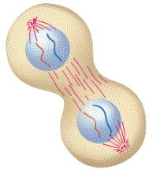
Telophase
When the chromosomes reach opposite ends, the spindle fibers disappear
Chromosomes de-condense into chromatin
Nuclear membrane forms around each set of chromosomes
Cell membrane begins to pinch in creating a cleavage furrow

Slide 12
Cytokinesis
Division of cytoplasm
Cell membrane pinches cell in half to yield 2 diploid daughter cells

Slide 13
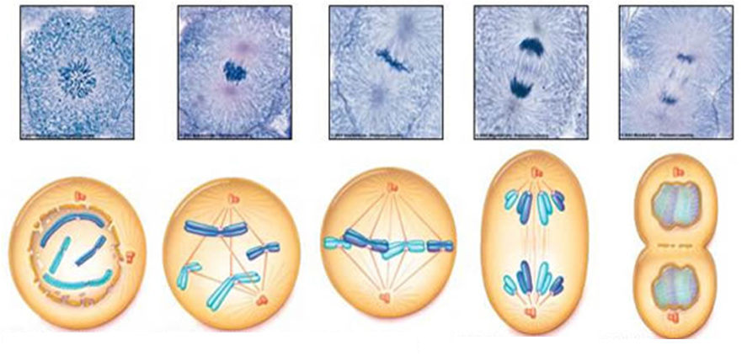
Metaphase
Anaphase
Telophase &
Cytokinesis
Prophase

