Slide 1
Meiosis

Slide 2
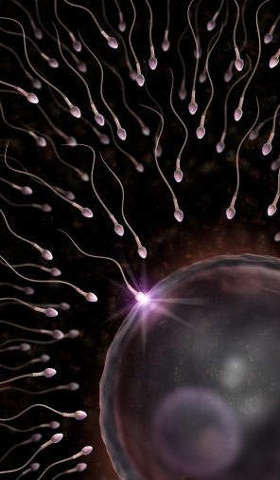
Meiosis
Cell division that reduces the number of chromosomes in new cells to half the number in the original cell.
Product of meiosis are haploid (1n) reproductive (sex) cells called gametes.
Sperm in males
Eggs in females

Slide 3
Meiosis
Undergoes G1, S, G2 of interphase
Divides twice instead of once like mitosis.
Result will be four haploid cells rather than 2 diploid cells.
Divided into Meiosis I and Meiosis II

Slide 4
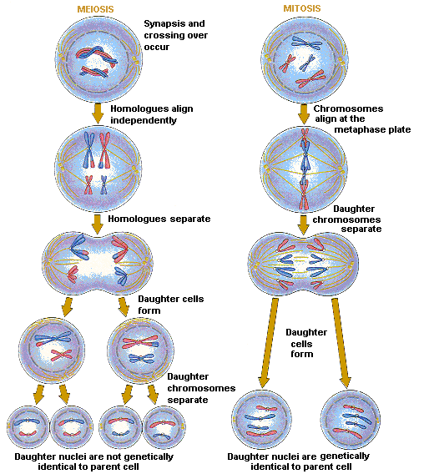
Meiosis
Mitosis
Get four haploid daughter cells!
Get two diploid daughter cells!

Slide 5
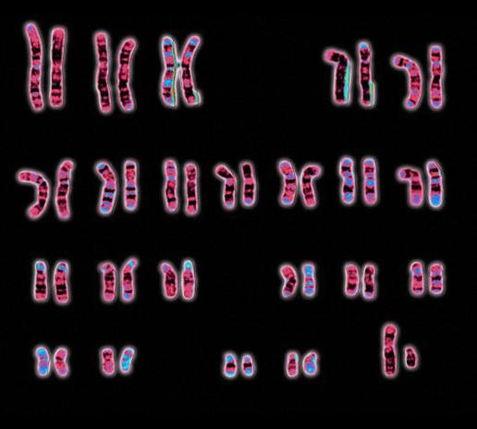
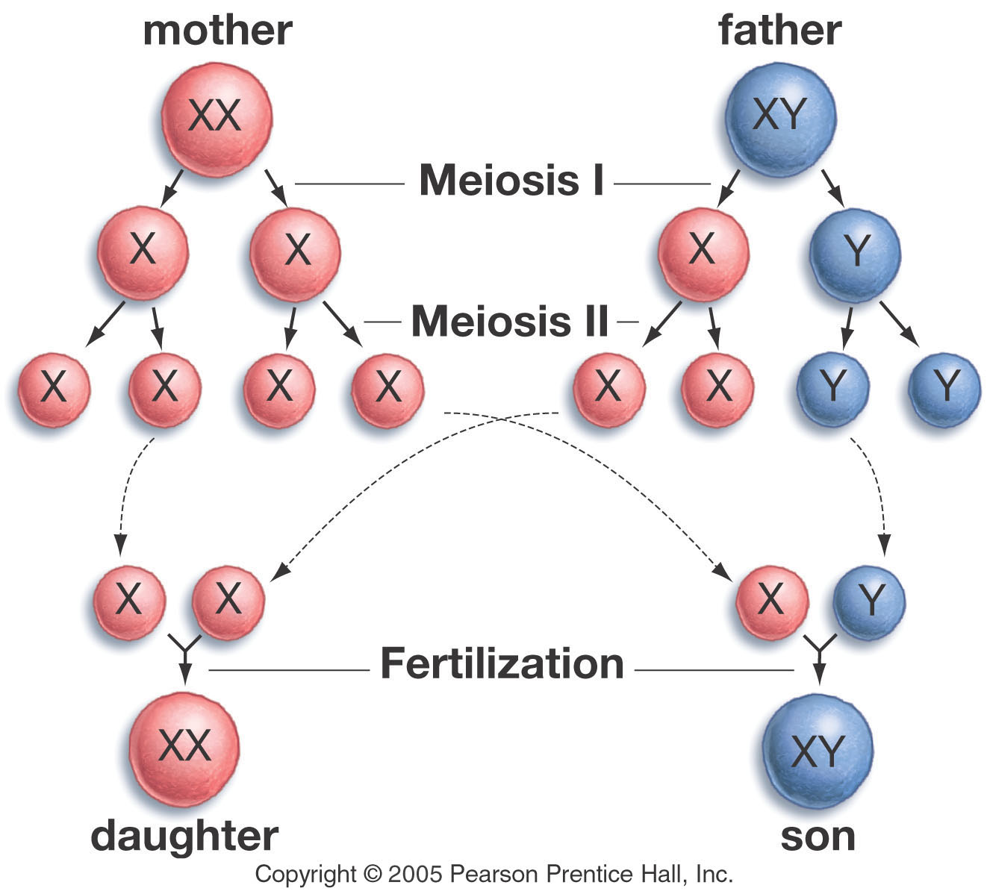
X Y
X X

Slide 6
Here is how it works…
1st Meiotic Division (aka Reductional Division)- the # of chromosomes is divided in half
2nd Meiotic Division (aka Equatorial Division)- the # of chromosomes stays the same before and after this division

Slide 7
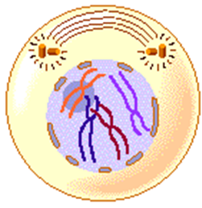
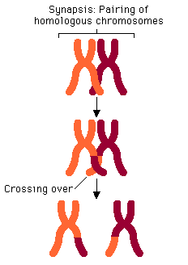
1st Meiotic Division
Prophase I- Homologous chromosomes pair up & condense, nuclear membrane disappears, spindle fibers form & cross over of chromosomes occurs (new combo. of genes)

Slide 8
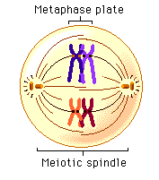
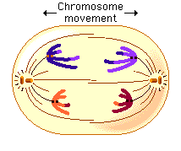
Metaphase I: Homologous chromosomes line up at the center of the cell
Anaphase I: Homologous chromosomes separate

Slide 9
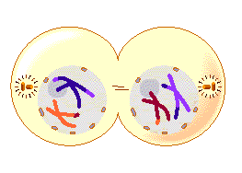
Telophase I: nuclear membrane forms around each cluster of chromosomes
Cytokinesis: separation of cytoplasm

Slide 10
Recap: Meiosis I results in…
Two daughter cells
Sister chromatids have NOT separated yet
Daughter cells have chromosome that are different from each other

Slide 11
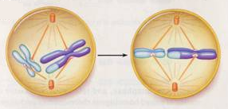
Meiosis II
Prophase II: Nuclear membrane disappears & spindle fibers form
Metaphase II: sister chromatids up at the center of the cell

Slide 12
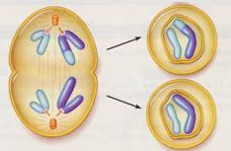
Anaphase II: centromere breaks down; paired chromatids separate (each is now considered a chromosome)
Telophase II & Cytokinesis: Results in four haploid cells

Slide 13
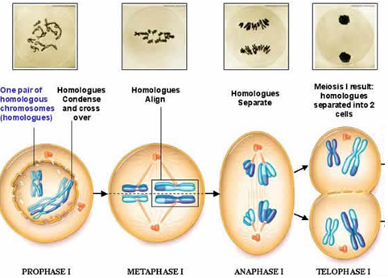
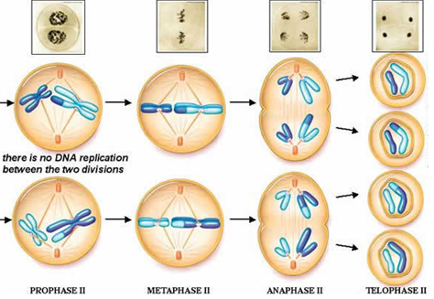
Meiosis II
Meiosis I

Slide 14
Types of Meiosis
Spermatogenesis
Occurs in the male testes
Diploid reproductive cell divides to form 4 haploid spermatocytes
Spermatocytes develop into mature sperm
Oogenesis
Occurs in the ovaries of females
Diploid reproductive cell divides to form oocytes
1 mature egg cell (receives most cytoplasm) and 3 polar bodies

Slide 15
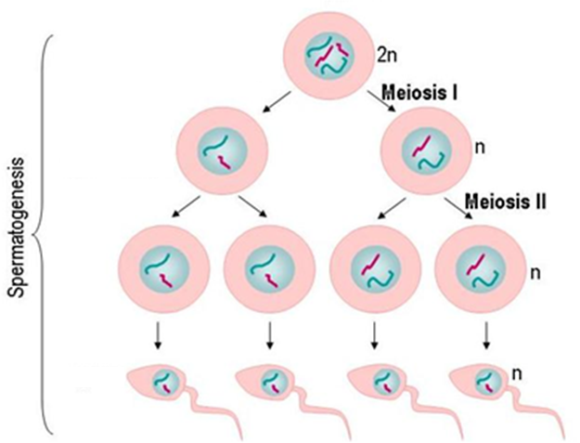
Spermatogenesis
Reproductive Cell
Spermatocyte
Men are busy – meiosis produces roughly 250,000,000 sperm per day.

Slide 16
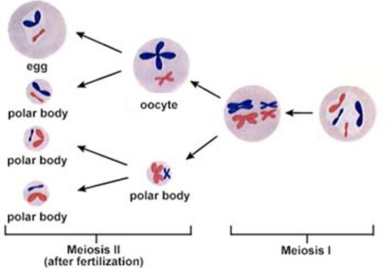
Oogenesis
Reproductive Cell
Woman are less busy in meiosis than men – meiosis produces only a few hundred mature eggs over a lifetime.

Slide 17
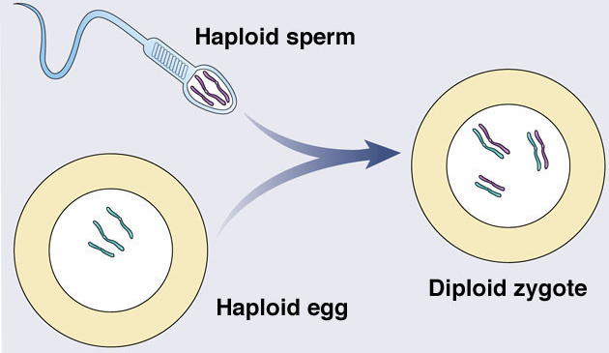
“Putting It All Together” - Fertilization

Slide 18
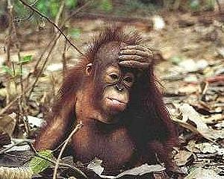
Fertilization:
Gametes combine to form a zygote.
Chromosomes come together to form homologous chromosomes.
The zygote will then divide through mitosis and grow into a living being.

Slide 19
Mitosis
Meiosis
Somatic cells or Autosomes
Makes more cells.
Divide Once =
2 Diploid Cells (2n)
Four Phases:
Prophase
Metaphase
Anaphase
Telophase
Sex cells or gametes
Makes more sex cells. (Sperm & Egg)
Divide Twice=
4 Haploid Cells (1n)
Two Major Phases:
Meiosis I
Meiosis II

Slide 20
Asexual Repro.
Sexual Repro.
Production of offspring from one parent
Does not usually involve meiosis
Usually occurs through binary fission or mitosis (unicellular)
Budding in multicellular
Genetically identical to parents
Production of offspring through meiosis & the union of sperm and egg.
Genetically different from the parents due to genes combined in new ways
Advantage is it enables species to adapt quickly to new conditions

