Slide 1
Frogs

Slide 2
Vertebrates
Have a backbone
Include: fishes, reptiles, amphibians, birds and mammals
Integument→ makes hair, scales, or feathers
Bony or cartilaginous endoskeleton
Movement by muscle attachment
Closed circulatory system
Two sexes (most)

Slide 3
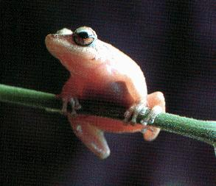
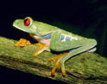
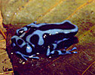
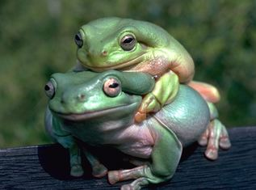
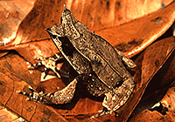
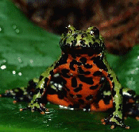
Anurans

Slide 4
Anurans
Kingdom: Animalia
Phylum: Chordata (has a backbone)
Class: Amphibia
Order: Anura “Without a tail”
Frogs, toads

Slide 5
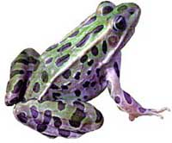
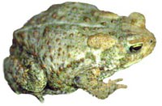
Frogs vs. Toads
Frogs
Toads
cold blooded
smooth or slimy skin
strong, long legs and webbed hind feet
two bulging eyes
lay eggs in clusters
a group of frogs is called ARMY of frogs
cold blood
warty and dry skin
stubby bodies with short hind legs
parotid (saliva) glands behind eyes
lay eggs in long chains
a group of toads is called a KNOT of toads

Slide 6
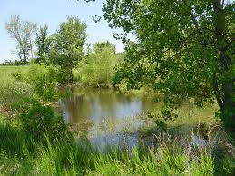
Habitat
Moist regions
Including ponds, creeks, and other water sources
Generally in areas with a lot of plants
Habitat provides food
Insects
Snails
Spiders
Worms
Small fish
Entire meal is swallowed
Sticky tongue is used to catch prey while the jaws are used to hold it

Slide 7
5 Characteristics of Modern Amphibians
Legs
Lungs
Cutaneous Respiration
Double-loop Circulation (Closed)
Partially divided heart

Slide 8
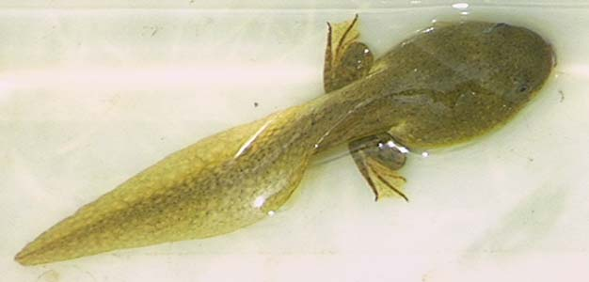
1. Legs
Evolution of legs key adaptation for living on land

Slide 9
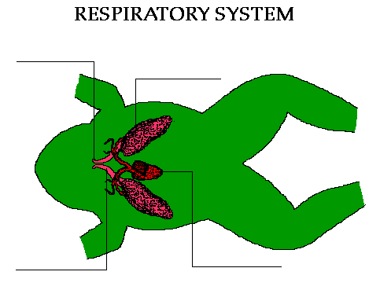
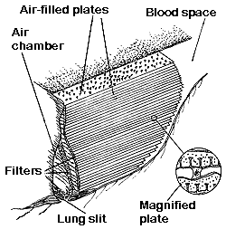
2. Lungs
Tadpoles have gills
Frogs have book lungs
Increases SA of the lung increasing the amount of oxygen absorbed
No diaphragm
Closed mouth when breathing
Throat movement pulls in air
Notes:
Frogs breath with their mouths closed. Their throat movements pulls air through the nostrils to the lungs. Then breathe out with body contractions.
The activity and temperature of an animal determine how important breathing is. Anurans have much more complex lungs then other amphibians, such as salamanders, because they're more active and have higher body temperature.

Slide 10
3. Cutaneous Respiration
“Skin breathing”
Supplement oxygen is taken in by respiring directly through the moist skin
Important during winter when they burrow into the bottom of mud of ponds (cease all lung breathing)

Slide 11
4. Double-Loop Circulation
Two separate loops
Pulmonary Circulation- carries blood between the heart and lungs
Systemic Circulation- oxygenated blood to the body & deoxygenated blood back to the heart
Advantage: oxygenated blood is pumped to the tissue at a higher pressure & faster rate

Slide 12
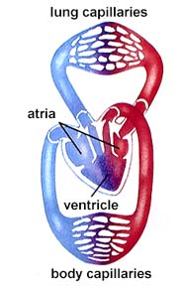
5. Partially Divided Heart
The Atria of the heart is divided into left and right sides
Ventricle is not divided
This causes oxygenated and deoxygenated blood to mix inside of the ventricle
Notes:
RA, PV to LA, Ventricle

Slide 13
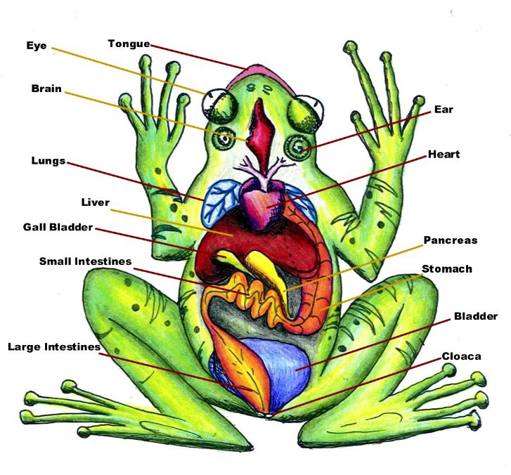

Slide 14
Excretory System
Represented by a pair of kidneys & urinary bladder
Kidneys-organs that filter blood, remove urea and convert it into urine
Urine is collected through ureters and stored in the bladder until excreted

Slide 15
Digestive System
esophagus
stomach
(
(
Liver- produces bile
Small intestine
gallbladder
Large intestine
Cloaca- stores waste

Slide 16
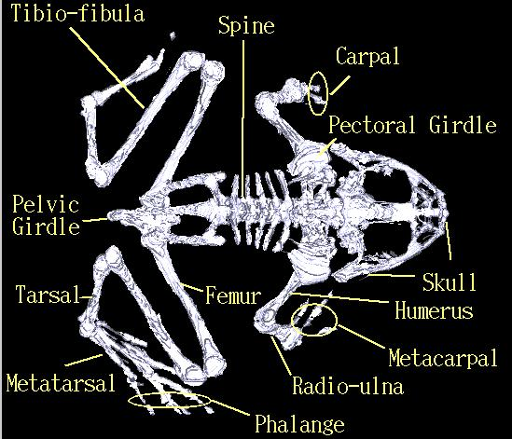
Skeletal System Diagram

Slide 17
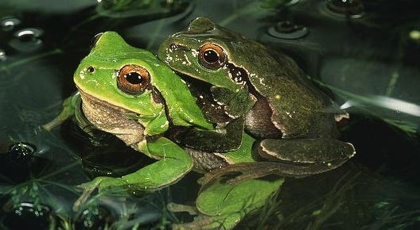
Reproduction
Depends on presence of water and land to complete life cycle
Female releases eggs into water and a male’s sperm fertilize them externally
Few days and fertilized eggs hatch into tadpoles
Dramatic physical change = metamorphosis

Slide 18
