Slide 1
DNA History

Slide 2
Scientists who discovered DNA
Frederick Griffith, 1928
Discovered transformation: the transferring of genetic material from one organism to another
Infected mice with strains of pneumonia
Oswald Avery, 1944
Discovered that DNA is the “transforming” genetic material that is passed on

Slide 3
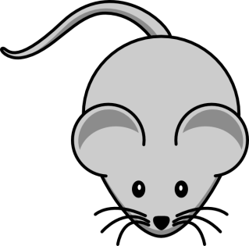
Experiment:
Took disease causing pneumonia and destroyed the lipids, carbs., and proteins with enzymes
Took disease causing pneumonia and destroyed the DNA

Slide 4
Scientists who discovered DNA
Erwin Chargaff, 1949
Discovered that % of A and T bases and % of C and G bases are almost equal in DNA
Nitrogenous Bases (%)
Organism | A | G | T | C
Human |  | 19 | 31
Chicken | 28.8 |  |  | 21.5
Bacterium (S. lutea) | 14

Slide 5
Scientists who discovered DNA
Alfred Hershey & Martha Chase, 1952
Reconfirmed that DNA was the transforming material
Experiment:
Radioactively marked viruses
Protein coat on viruses were marked with Sulfur
DNA was marked with Phosphorous
Virus injected genetic material into bacteria
Bacteria was tested for radioactivity
Results
Radioactivity from Phosphorous… DNA is found in genes

Slide 6
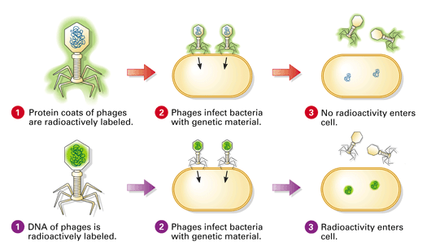

Slide 7
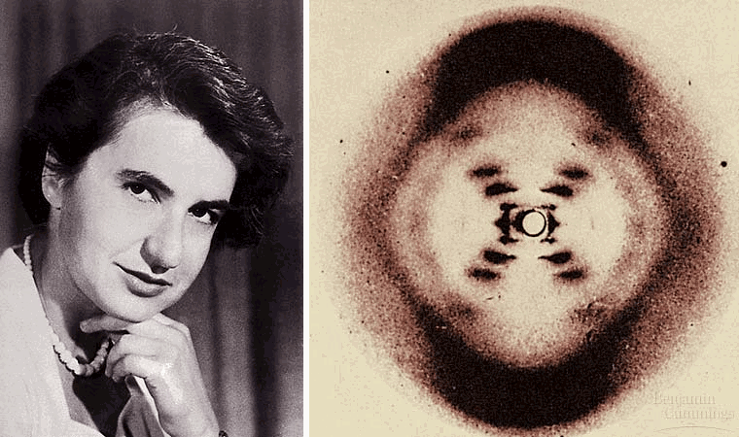
DNA Structure History
Rosalind Franklin & Maurice Wilkins, 1952 - used X-ray photographs of DNA crystals
Found the following:
DNA strands are twisted around each other
Composed of 2 strands in the structure
Nitrogenous bases are near the center

Slide 8
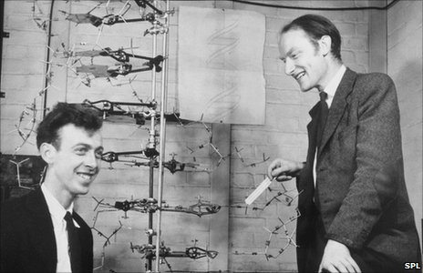
DNA Structure History
Watson and Crick- suggested a model for the structure of DNA (1953)
Relied heavily on scientist before them
Won the Nobel Peace prize for their discovery
Were they right?

Slide 9
DNA Function
Stores Info.→ genes for controlling patterns of development
Copying Info
Transferring Info
Replication, Transcription
and Translation

Slide 10
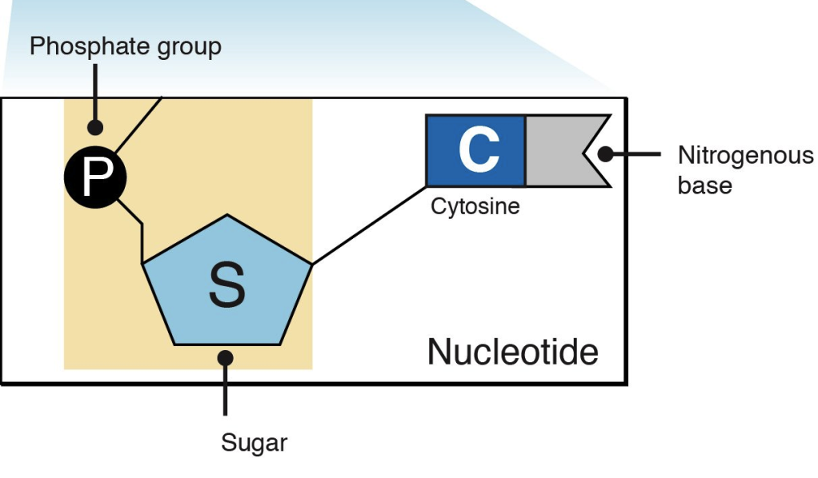
DNA Composition
Subunit of DNA= nucleotide
Anatomy of a nucleotide
Sugar (five carbon deoxyribose)
Phosphate group (P)
Nitrogenous Bases

Slide 11
Bases
Purines- A-adenine and G- Guanine
Pyrimidines- T-Thymine and C-Cytosine
Chargaff’s Rule: A-T and C-G
Joined by covalent bonds (H bonds)

Slide 12
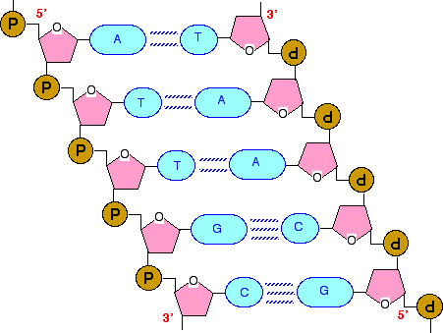
Arrangement
Nitrogenous base is always attached to the sugar
One direction is 5’-3’
Starting with phosphate: P
Other direction is 3’-5’
Starting with sugar

Slide 13
