Slide 1
Design Process

Slide 2
The Design Process
OBSERVATION or identify a problem.
Form a question.
HYPOTHESIZE (testable explanation for the observation).
The hypothesis may be stated as a question.
EXPERIMENT to test the hypothesis.
ANALYZE data
CONLUDE the results
Notes:
No research method is applied universally. Problems are approached and solved with imagination, creativity, and prior knowledge.

Slide 3
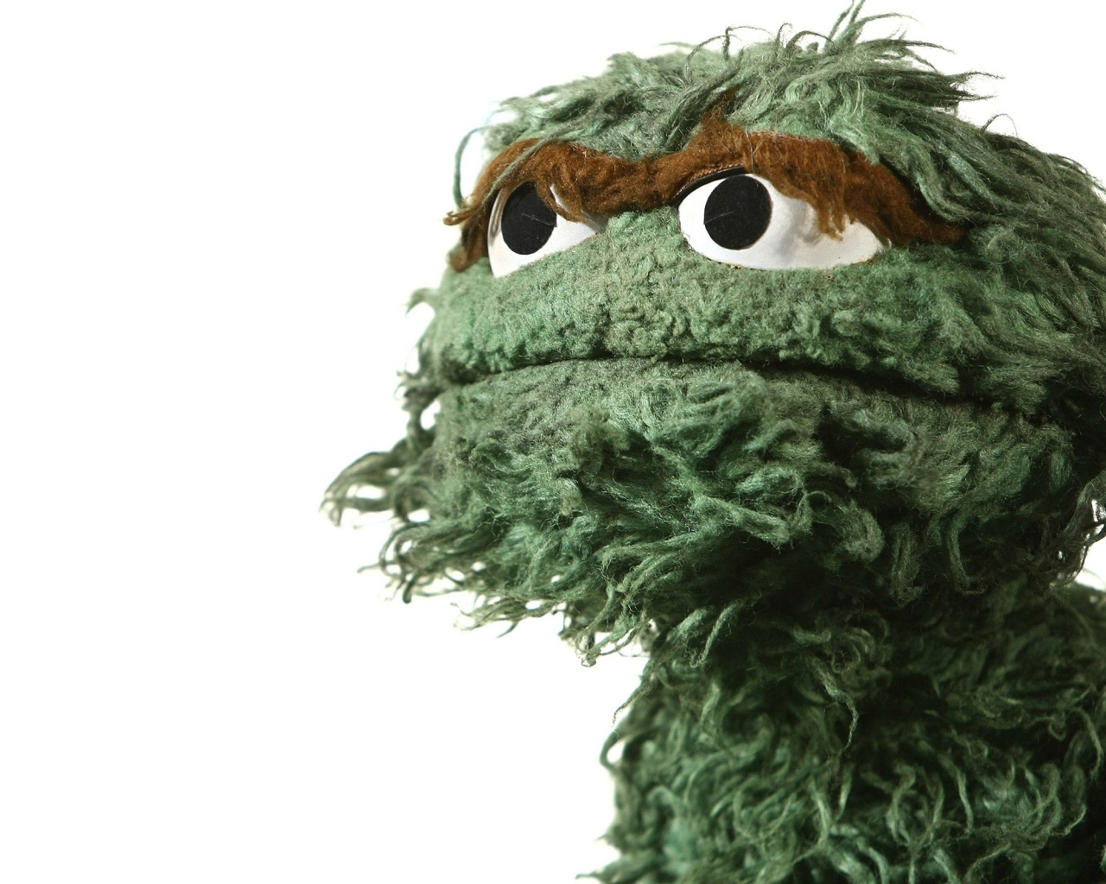
Mnemonic for the Design Process
Oscar
Hates
Eating
Apple
Chips

Slide 4
Design Process
Make Observations
Ask a Question
Background Research
Form a hypothesis
Think! Try Again!
Test w/ an experiment
Analyze results
Draw Conclusion
Hypothesis is true
Hypothesis is false or partially true
Report Results

Slide 5
Design Process
Science originates in questions about the world.
Once a question is asked, inquiry begins
Science uses observations to construct inferences and explanations.
Combining observations creates a stronger explanation.

Slide 6
We begin with the following…
Observation
Inferences
Gathering of information by using our five senses
Act of noticing/ describing events or processes
Explanation for an observation you’ve made (based on past experiences and prior knowledge)
Interpretation based on what scientists already know
?
Hypothesis

Slide 7
Some Examples
Observation: The grass on the my lawn is wet
Possible Inferences:
It rained
The sprinkler was on
There is dew on the grass from the morning
A dog urinated on the grass

Slide 8
Archeological Dig!
The next slides show fossil imprints found during an archeological dig.
Record some observations & make some inferences about what may have happened...

Slide 9
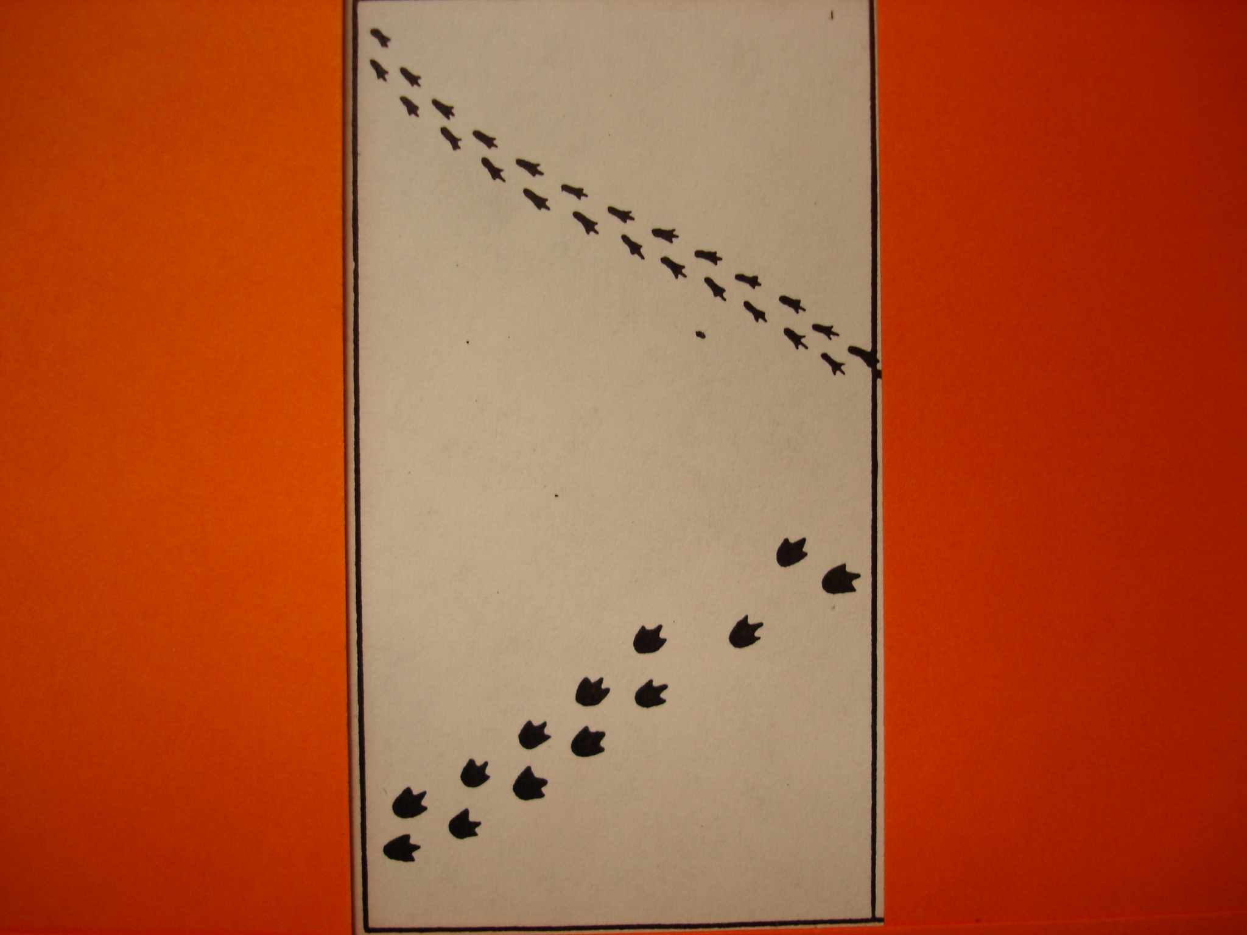

Slide 10
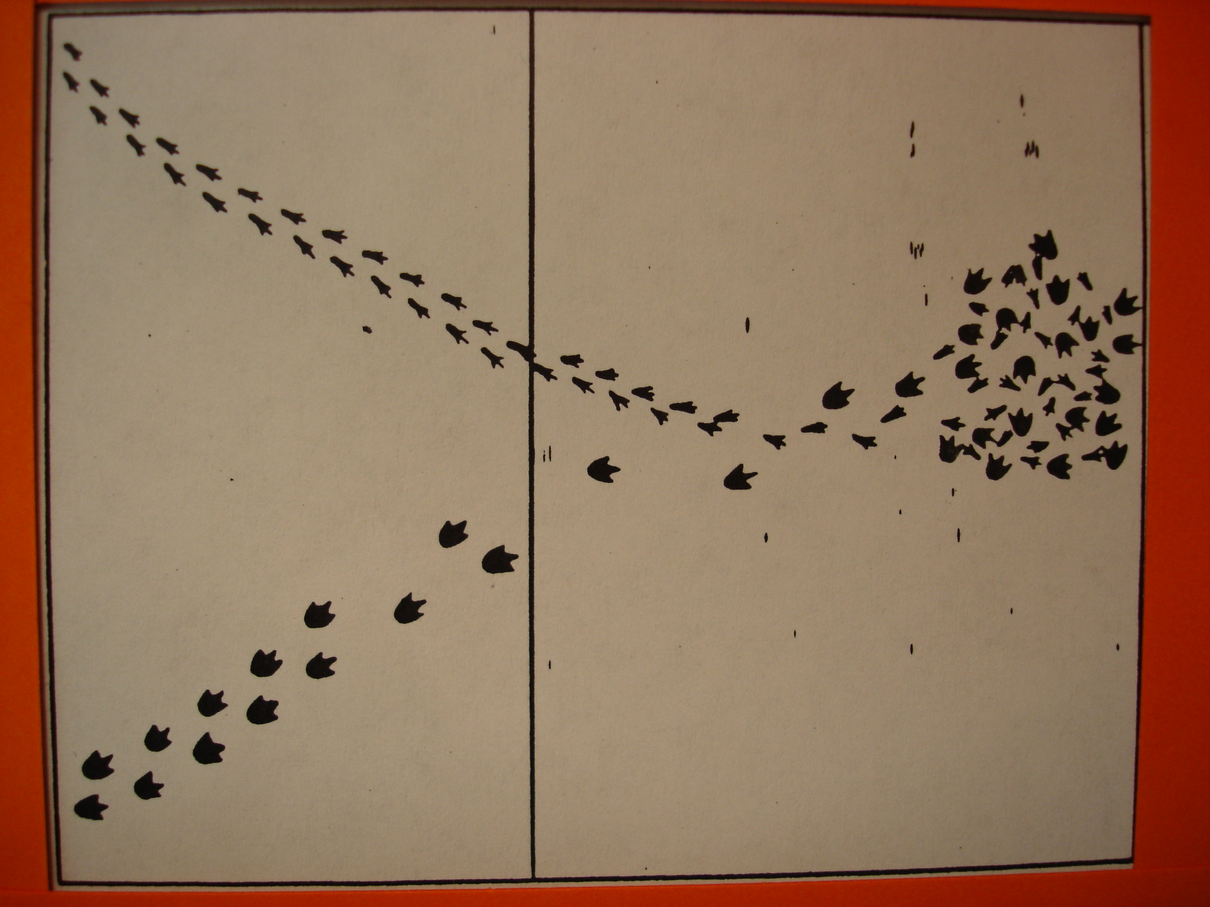

Slide 11
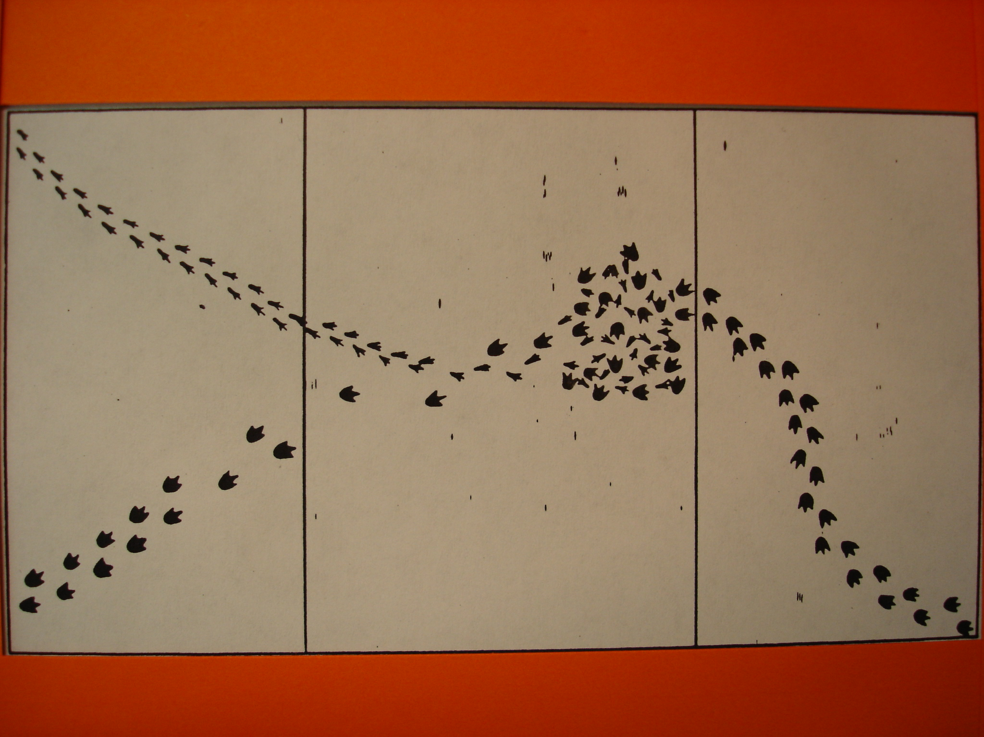

Slide 12
Your Task
You must make two observations & two inferences for every picture I show you!

Slide 13
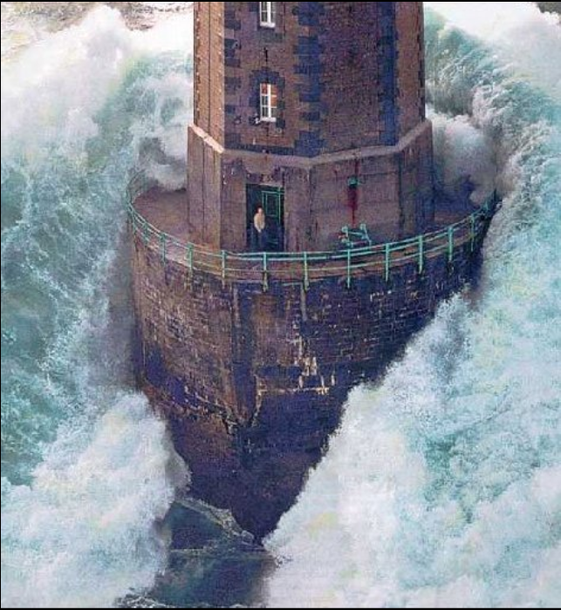

Slide 14
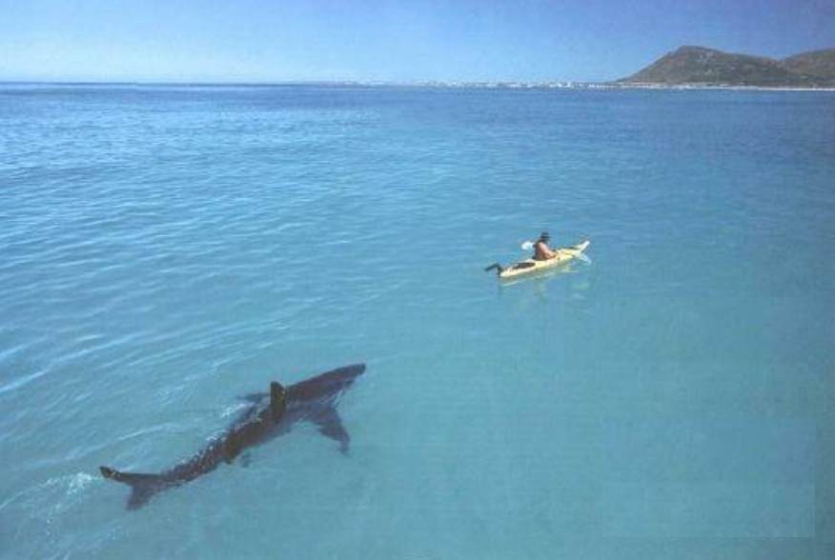

Slide 15
Experimentation
Experiment
Independent Variable
Dependent Variable
Constants
Independent variable is controlled by the experimenter.
Dependent variable variable observed that changes in response to the independent variable.
Constants are factors that do not change during an experiment.

Slide 16
Example:
Experiment involves how much a person exercises.
Independent variable- type of exercise
Dependent variable- their heart rate
Constant- amount of oxygen in the air

Slide 17
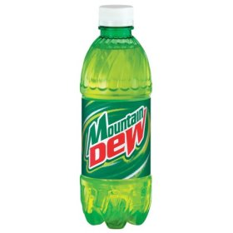
For example:
If I drink Mountain Dew before bed, then I will not sleep very much.
IV:
DV:
C:
drinking Mountain Dew
the amount of sleep
the amount of Mountain Dew
Notes:
the amount of sleep

Slide 18
Another Examples
If I leave all the lights on all day, then my electric bill will be expensive
IV: __________________
DV: _________________
C: ______________
Leave the lights on
Expensive Bill
Other electric expenses

Slide 19
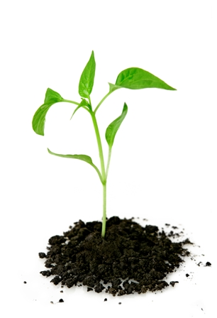
Ie.
If you were measuring the growth rate of plants under full sunlight for 8 hrs. a day versus plants that only have 4 hrs. of full sunlight per day.
IV: ________________
DV: __________________
C: ___________________
Amount of sunlight
Growth rate of the plant
Amount of water

Slide 20
Dependent Variable
Can there be more than one Dependent and Independent Variable?
Independent Variable
There can be more than one DV
Growth rate= one DV
Overall height of plant= another DV
There can only be one IV for any experiment
More than 1 IV means the results can’t be pin-pointed to a specific variable that caused it

Slide 21
Control & Experimental Groups
Experimental group- the group of subjects who receive the IV
Control group- exposed to the same conditions as the experimental group except for the IV

