Slide 1
Darwin’s Voyage of Discovery

Slide 2
Epic Journey
Charles Darwin was born in England on February 12, 1809
Grew up during a time when the scientific view of the natural world was shifting
Geologists were suggesting that Earth was ancient and changed over time
Developed a theory of biological evolution
Evolution = change over time
Explains how modern organisms evolved over long periods of time through descent from common ancestors

Slide 3
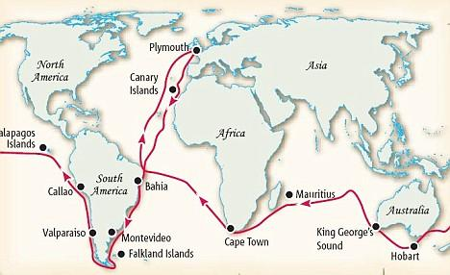
Epic Journey
HMS Beagle’s 5 year voyage started in 1831
Captain and his crew were mapping the coastline of South America
Darwin planned to collect specimens of plants and animals

Slide 4
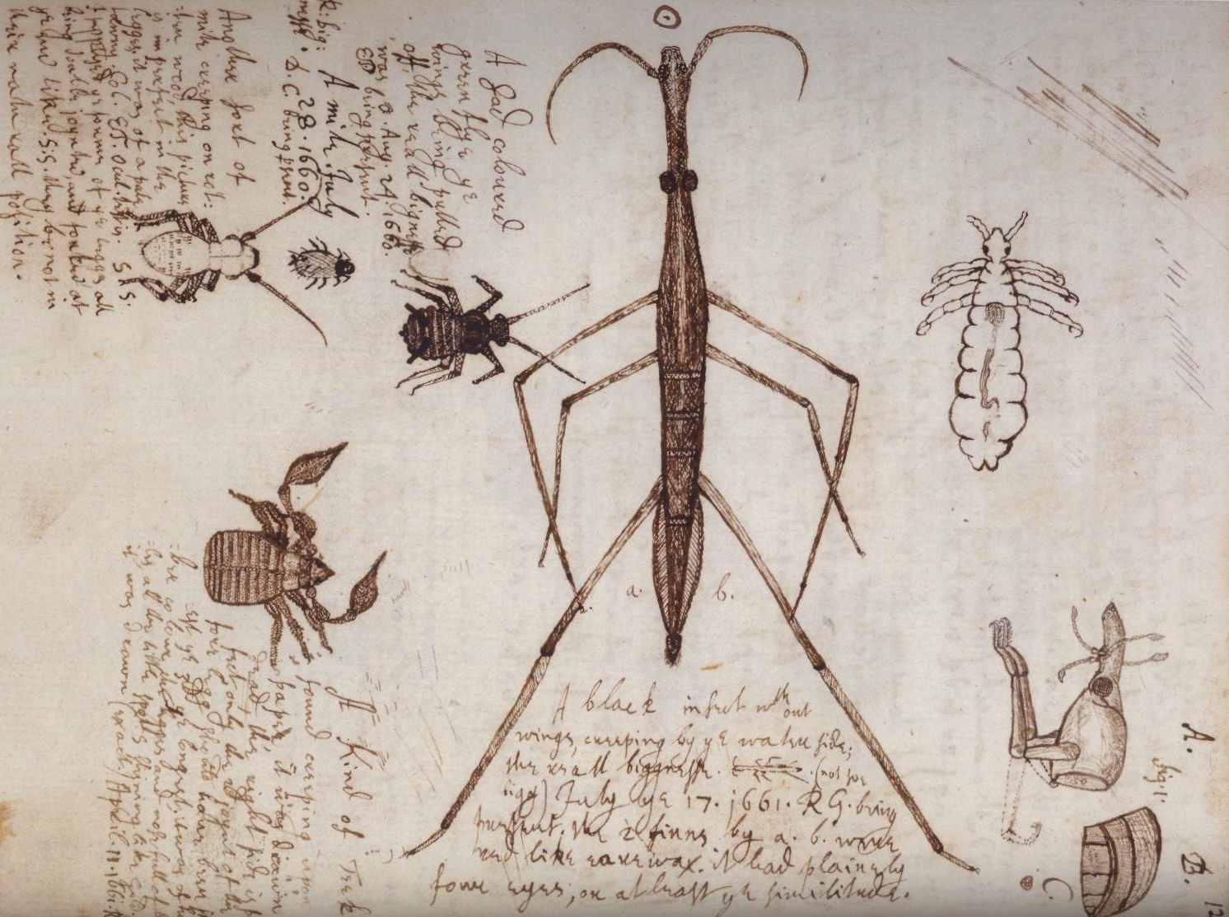
Observations Aboard the Beagle
In a day trip to the Brazilian forest, he collected 68 species of beetles
Filled notebooks full of observations about the characteristics and habitats of different species
Noticed three distinctive patterns:
Species vary globally
Species vary locally
Species vary over time

Slide 5
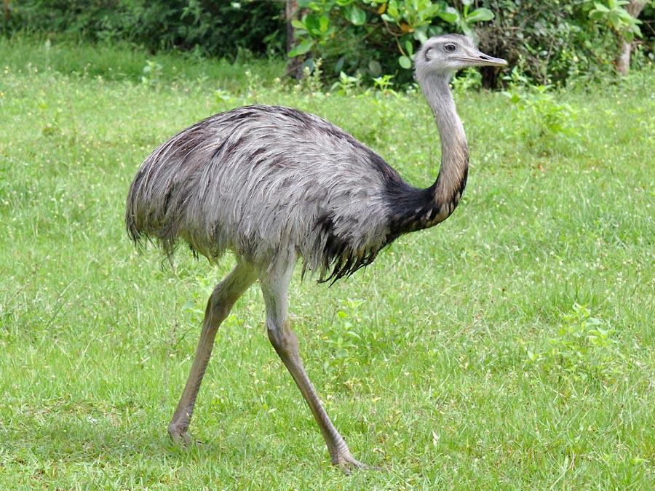
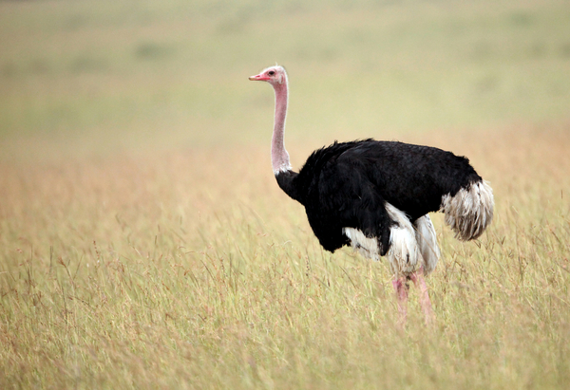
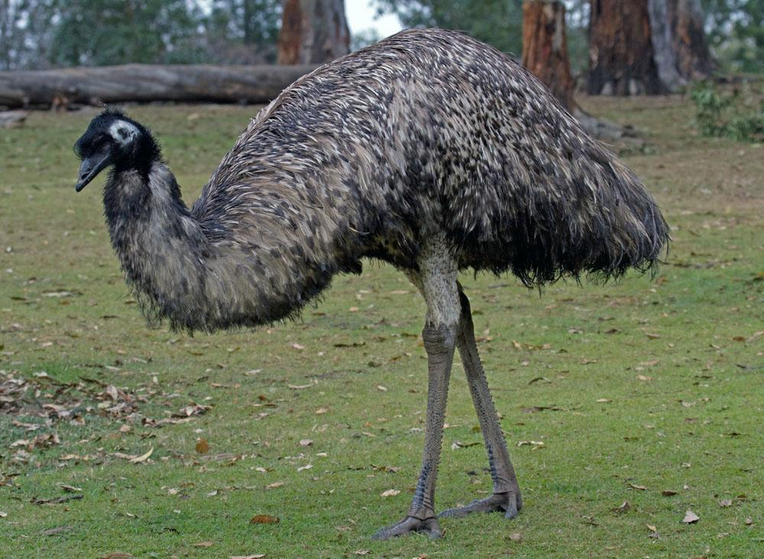
Species Vary Globally
Visited South America, Australia and Africa
Found flightless, ground dwelling birds in South America
Rheas (look like Ostriches) live only in South America
Ostriches only live in Africa
Emu live in Australia
Found that different species (even similar ones) inhabited separate habitats around the globe (even similar habitats)

Slide 6
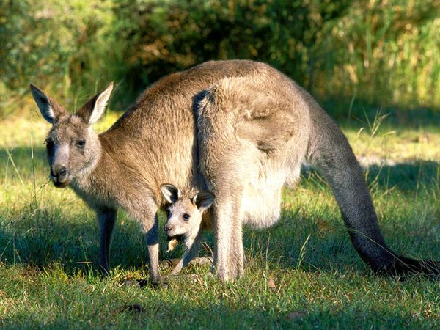
Species Vary Globally
Other things he noticed
Rabbits and other species living in European grasslands were not found in South America or Australia
Australia’s grasslands had animals found nowhere else
Kangaroos

Slide 7
Species Vary Locally
Discovered that two species of Rheas living in South America
One lived in Argentina’s Grasslands and the other lived in the colder, harsher grass and scrubland to the south
Noticed that different, yet related, animals species often occupied different habitats within a local area
Other different species
Tortoises, mockingbirds, finches

Slide 8
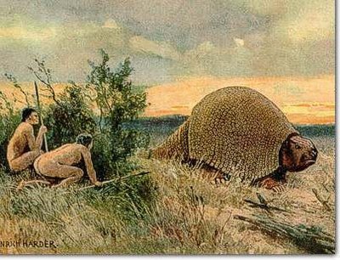
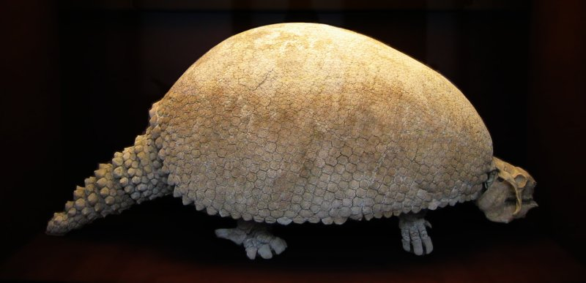
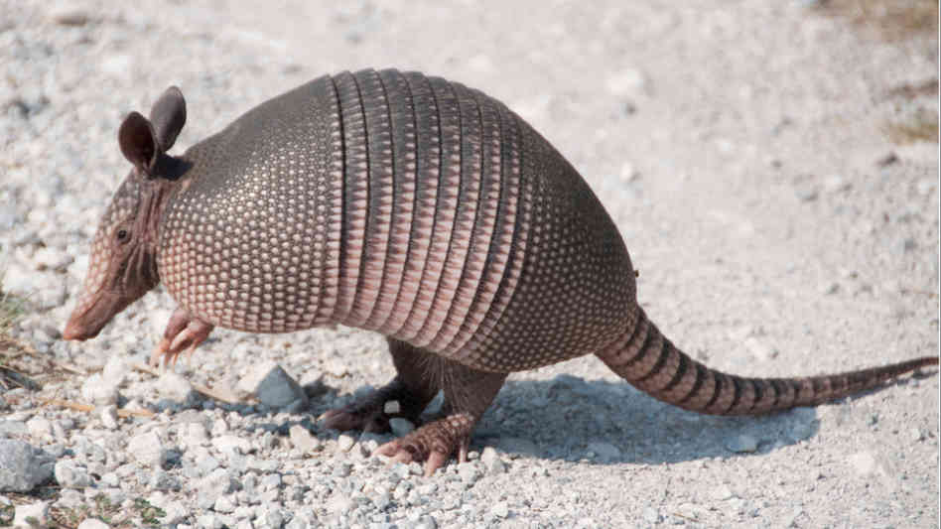
Species Vary Over Time
Darwin also collected fossils
Noticed that some fossils of extinct animals were similar to living species
Collected long-extinct glyptodont that was very similar to the armadillo

Slide 9
Putting the Pieces Together
Darwin was stunned by his findings
He began to wonder if different Galapagos species might have evolved from South American ancestors
He spent years researching and filling notebooks with ideas about species and evolution
The evidence suggest that species are not fixed and that they could change by some natural process

