Slide 1
Cell Transport

Slide 2
Homeostasis
What is homeostasis?
How do the terms homeostasis and equilibrium relate to each other?
What are the functions of the cell membrane?
How do you think the cell membrane helps the cell maintain homeostasis?

Slide 3
Cell Membrane (a.k.a.- Phospholipid Bilayer)
Function:
Selectively permeable- regulate movement in and out of cell
Supports, shapes and protects the cell
Communication with other cells
Double Lipid Layer
Gives membrane flexible structure
Forms a barrier btw. the cell and its surroundings

Slide 4
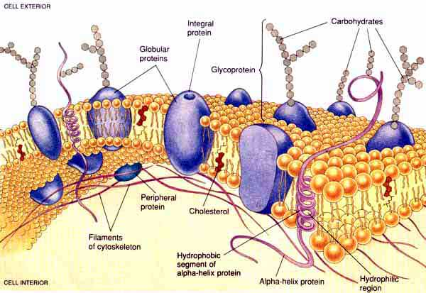
Components of the Cell Membrane
The cell membrane is made up of three structures:
Phospholipids
Proteins
Carbohydrates

Slide 5
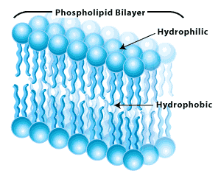
Phospholipids
Double Lipid Layer
Gives membrane flexible structure
Forms a barrier btw. the cell and its surroundings
Structure
Tail= hydrophobic
Head= hydrophilic

Slide 6
Movement Across the Plasma Membrane
Passive Transport- cellular energy is not used
Diffusion
Osmosis
Facilitated Transport
Active Transport- materials move against a concentration difference; requires energy
Protein Pumps
Vesicles-movement of LARGE molecules (ie. Endocytosis and Exocytosis)

Slide 7
Passive Transport
Passive Transport- the process in which substances move into/out of the cell w/o the use of energy
Movement of substances is based on…
Concentration gradient- the difference in # of molecules per vol. of substance between a high and low concentration region
Notes:
Gated→ allow entry and exit of charged substances

Slide 8
3 Types of Passive Transport
Diffusion
Osmosis
Facilitated Diffusion

Slide 9
1. Diffusion
Diffusion- net movement of molecules/ions down a concentration gradient (high to low conc.).
Examples: spraying air freshener, making tea
or kool-aid
Notes:
Water and dye

Slide 10
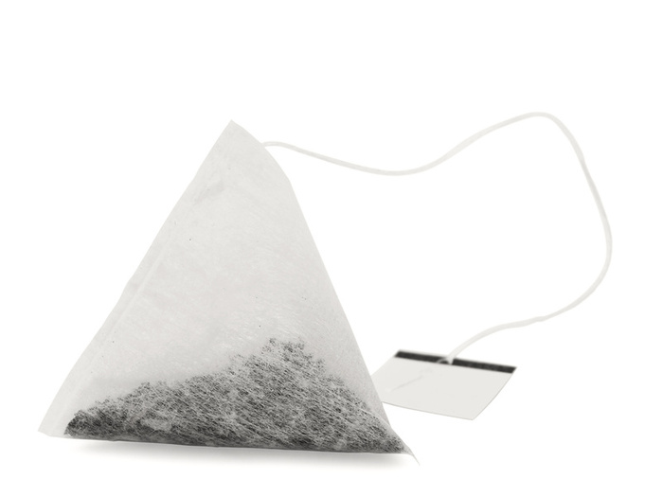
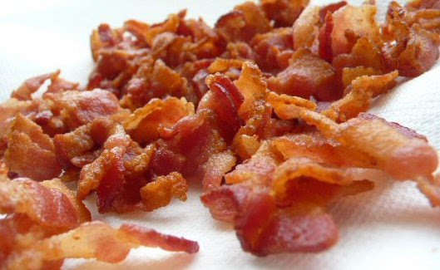
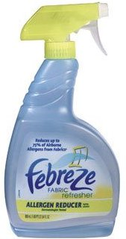
Tea
TOOT
Air
Freshener
Cooked Bacon

Slide 11
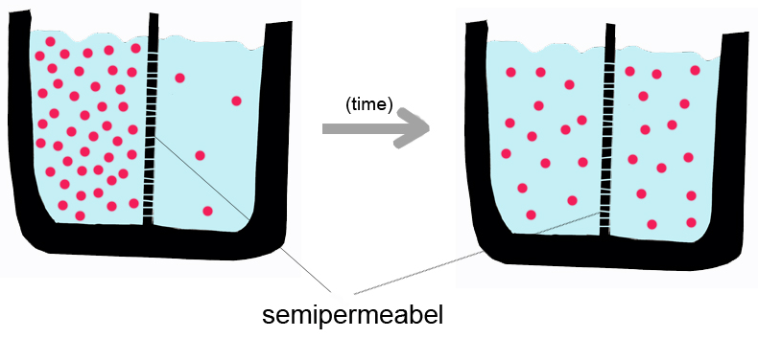
Diffusion
Solute- substance that is dissolved in a solution.
Solvent- Dissolving substances in a solution.
Solution- type of mixture in which all substances are evenly distributed
http://www.youtube.com/watch?v=s0p1ztrbXPY&feature=related
Notes:
Another way of thinking about it is that if you have a liquid and it's not a pure substance, it's a solution. The liquid part is the "solvent" and the stuff you dissolved (usually a solid) is the "solute".

Slide 12
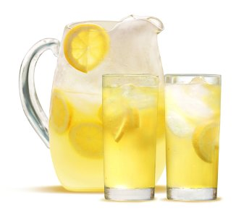
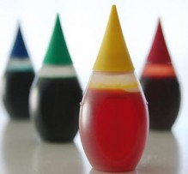
Guess the Solute and the Solvent

Slide 13
What determines diffusion rates
Gradient’s steepness- faster
Molecular size- smaller molecules move down concentration gradient quicker
Temperature- ↑ heat causes molecules to move faster/collide

Slide 14
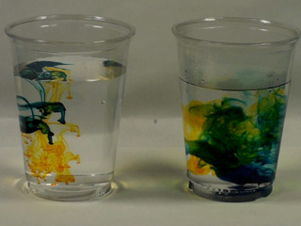
What affects diffusion?
Beaker 1: Hot water (10 drops food coloring)
Beaker 2: Luke Warm Water (10 drops food coloring)
Beaker 3: Cold water (2 drops food coloring)

Slide 15
What affects diffusion?
Beaker 1: Luke warm water (4 drops food coloring)
Beaker 2: Luke warm Water (2 drops food coloring)
Beaker 3: Luke warm water (1 drop food coloring)

Slide 16
Osmosis
Osmosis- the process by which water molecules diffuse across a cell membrane from a low concentration of solutes to a high concentration of solutes.

Slide 17
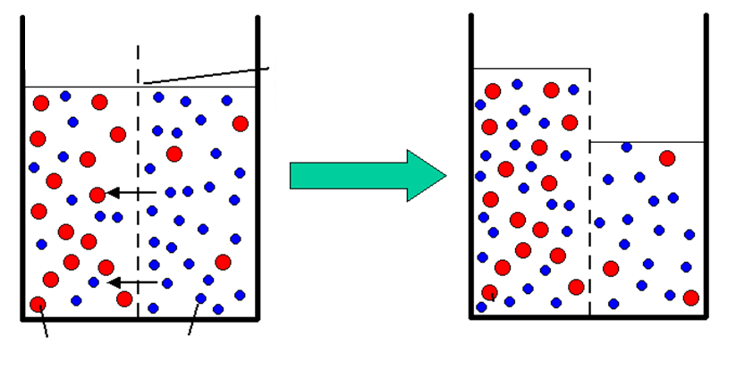
Osmosis
High conc. of solute/ low conc. of H2O
Low conc. of solute/ high conc. of H2O
Water molecules pass through but not sugar
Permeable membrane
Sugar molecules
Water molecules
http://www.youtube.com/watch?v=XclGRjnilsk

Slide 18
Cells & Osmosis
The concentration of the solution that the cell is in, will affect the state of the cell.
Three types of solutions:
“Iso”tonic- think “same”
“Hyper”tonic- think “above”
“Hypo”tonic- think “below”

Slide 19
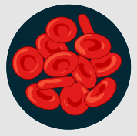
Isotonic Solution
Isotonic solution- the concentration of solutes outside the cell, is equal to the amount solutes of molecules inside the cell.
Thus, no movement of water occurs into or out of the cell.
The cell remains normal or the same.

Slide 20
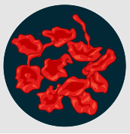
Hypertonic Solutions
Hypertonic solution- the concentration of solutes is higher on the outside of the cell than on the inside of the cell.
Thus, resulting in water moving from the inside of the cell to the outside of the cell.
The cell will shrink (crenate) or become smaller.

Slide 21
Hypotonic Solution
Hypotonic solution- the concentration of solutes is lower on the outside of the cell than on the inside of the cell.
Thus, resulting in water moving from the outside of the cell into the inside of the cell.
The cell will increase in size and could explode.

Slide 22
Accountable Independent Reading
While reading you need to:
Circle words that are associated with osmosis or diffusion
Underline the main point of the article

Slide 23
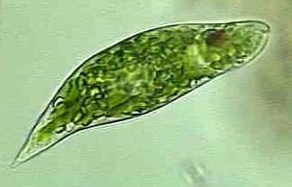
Unicellular Organisms
Most freshwater unicellular organisms remain in a hypotonic environment.
Therefore, they have contractile vacuoles to constantly remove water from their bodies.
This does require the use of energy and must occur or the organism will die.

Slide 24
Plant Cells
Most of the time plant cells live in hypotonic environments.
This results in water constantly moving into the cell.
Once the cell membrane begins to press against the cell wall turgor pressure develops.
This pressure will remain until water is diffused until equilibrium is reached.

Slide 25
Plasmolysis
Plasmolysis occurs when turgor pressure is lost.
Once turgor pressure is lost the cell shrinks away from the cell wall.
Plasmolysis is the reason plants wilt if they don’t receive enough water.

Slide 26
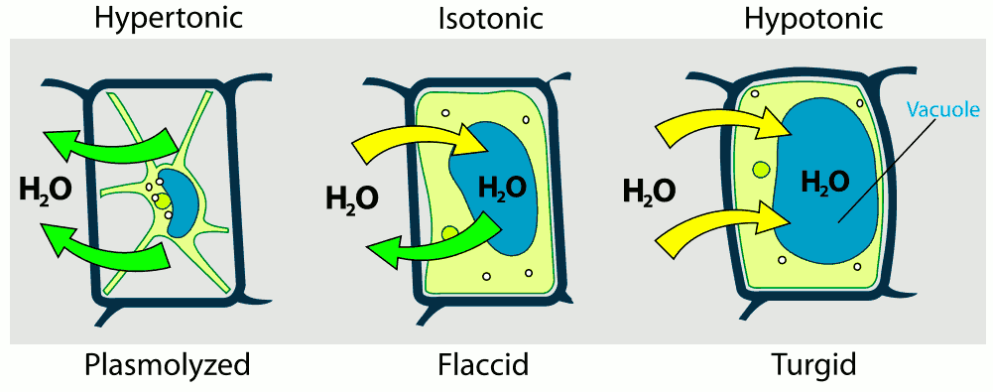
Turgor Pressure

Slide 27
Facilitated Diffusion
The movement of molecules across the membrane is with the assistance of carrier proteins located within the cell membrane.
Facilitated diffusion is the process used for molecules that can’t diffuse rapidly through the cell membrane.
This is due to the molecules being too large to pass through.

Slide 28
Facilitated Diffusion- Carrier Protein
A carrier protein binds to the molecule on one side of the membrane.
Typically a carrier will only transport a small group of related molecules.
The carrier protein changes shape as the molecule passes through.
The molecule is then released on the other side of the membrane.
Molecule still moves from a high to low concentration
Notes:
bind a specific type of solute and are thereby induced to undergo a series of conformational changes which has the effect of carrying the solute to the other side of the membrane. The carrier then discharges the solute and, through another conformational change, reorients in the membrane to its original state. Typically, a given carrier will transport only a small group of related molecules.

Slide 29
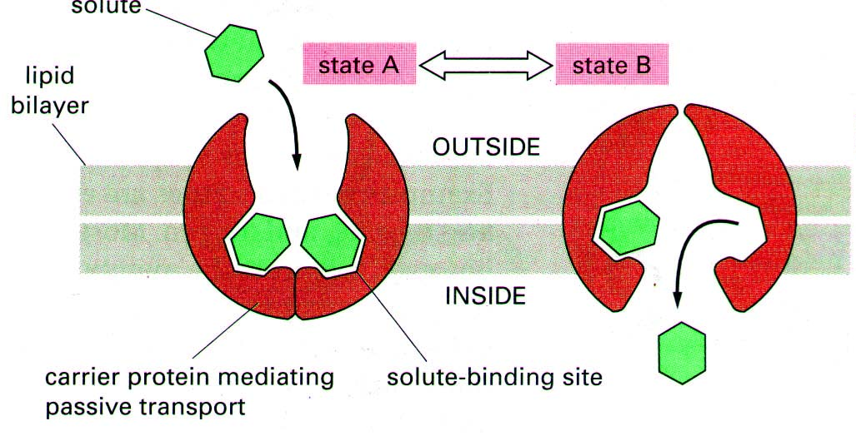
Carrier Protein

Slide 30
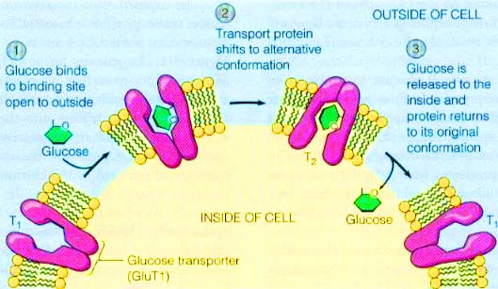

Slide 31
Cell Transport
Passive Transport- cellular energy is not used
Diffusion
Osmosis
Facilitated Diffusion
Active Transport- materials move against a concentration difference; requires energy
Endocytosis
Exocytosis
Vesicles- membrane- enclosed sacs that store/ transport substances; used to move LARGE molecules

Slide 32
Active Transport
The movement of substances is against the concentration gradient.
Meaning the substances flow from a low to a high concentration.
Energy, in the form of ATP is required
The types of active transport are:
Endocytosis
Pinocytosis
Phagocytosis
Exocytosis

Slide 33
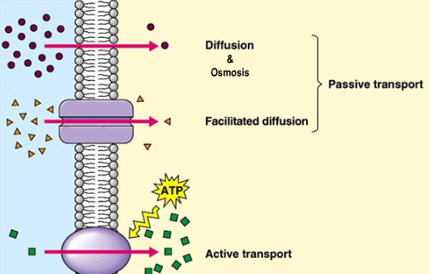
Recap. on Cell Transport
Notes:
Channel protein, carrier proteins

Slide 34
Active transport
Notes:
Active transport allows a solute (ion or molecule) to cross the membrane against its concentration gradient – from lower solute concentration to higher solute concentration. At (1), the molecule enters the carrier. During (2), the breakdown of ATP induces a change in shape that drives the molecule across the membrane. At (3), the carrier protein returns to its former shape or state.

Slide 35
Carrier proteins involved in active transport are called pumps.
The sodium-potassium pump is active in all animal cells, and moves sodium ions to the outside of the cell and potassium ions to the inside.
Notes:
The term “pump” is used because the carrier protein is using energy to pump a substance across a membrane against its concentration gradient, much like a water pump moves water against the force of gravity.

Slide 36
The sodium-potassium pump
Notes:
A carrier protein actively moves three sodium ions (Na+) to the outside of the cell for every two potassium ions (K+) pumped to the inside of the cell. Note that chemical energy of ATP is required.
In this view, the protein carrier has a shape that allows it to take up to three sodium ions (Na+).

Slide 37
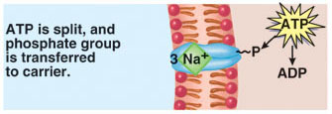
Notes:
In this view, ATP is split, and the terminal phosphate group is transferred to the carrier protein.

Slide 38
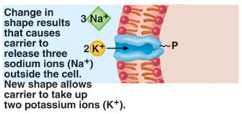
Notes:
The attached phosphate group from ATP allows the carrier protein to change in shape, and the three sodium (Na+) ions are released to the outside of the cell. The new shape (conformation) of the carrier protein allows the carrier to take up two potassium (K+) ions.

Slide 39
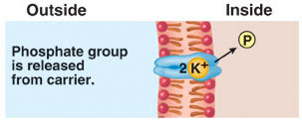
Notes:
When potassium ions are inside the carrier protein, the phosphate group is released from the carrier protein.

Slide 40
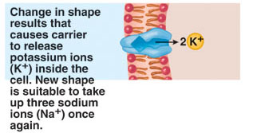
Notes:
Finally, a change in shape that occurs when the phosphate group is released, causing the carrier protein to release the potassium (K+) ions to the inside out the cell. The new (original) shape of the carrier enables it to take up three sodium (Na+) ions once again.

Slide 41
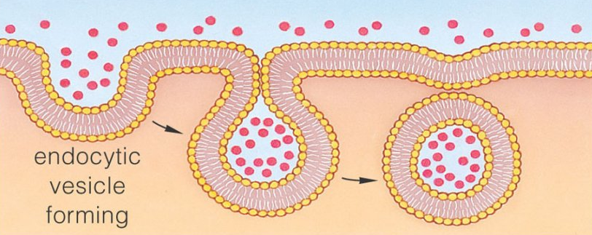
Endocytosis
Process of taking material (fluid, macromolecules, & large particles) into the cell by the infolding of the cell membrane
Infolding breaks loose from the cell membrane
This forms a vacuole within the cytoplasm
There are two types of endocytosis
Pinocytosis
Phagocytosis

Slide 42
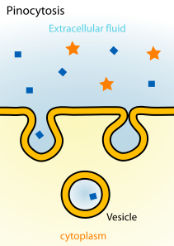
Pinocytosis
Form of endocytosis
Tiny pockets form along the cell membrane, these fill w/ liquid and pinch off as vacuoles
Vacuole- a membrane-bound cavity within a cell, often containing a watery liquid or secretion.

Slide 43
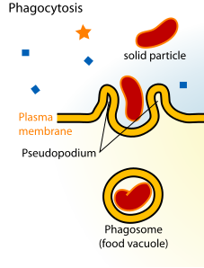
Phagocytosis
Type of endocytosis
Extensions of cytoplasm surround a particle & package it within a food vacuole

Slide 44
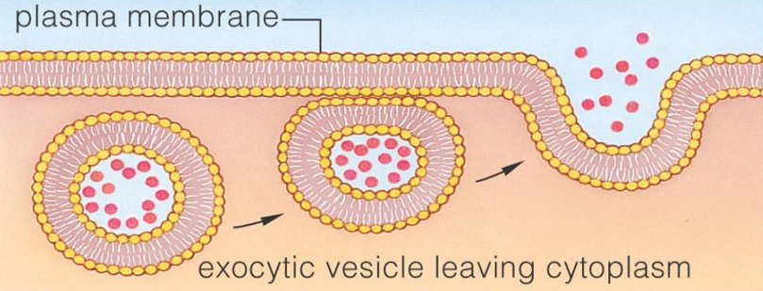
Exocytosis
Process of getting rid of cellular waste or secreting hormones (ie. Hormones from endocrine cells, mucous from secretory cells)
The membrane of the vacuole surrounding the material fuses w/ the cell membrane

Slide 45
