Slide 1
Cell Division

Slide 2
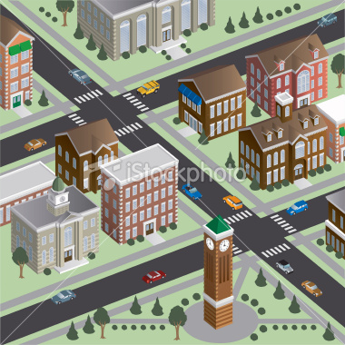
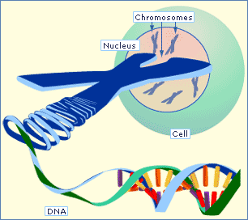
Limits to size
Larger a cell becomes, the more demands the cell places on DNA
Cell increases but DNA does not
Cell divides before becoming too large
Information crisis resolved when DNA divides
Analogy: Library in a small town

Slide 3
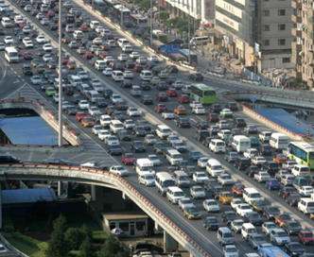
Limits to size
Need a large surface area and small volume!!!!!
Surface area to volume ratio
Food, oxygen water enter cell through membrane
Waste leaves cell through membrane
Traffic problems”
Difficult to get sufficient amounts of oxygen and nutrients in and waste products out

Slide 4
Cell Division
Prokaryotes
Structure
No nucleus, has a nucleoid
Reproduction
Binary Fission
Eukaryotes
Structure
Has a nucleus
Reproduction
Mitosis
Meiosis

Slide 5
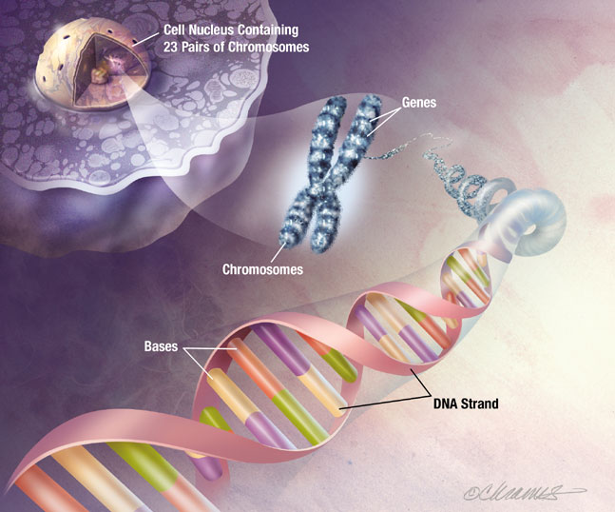
Chromosomes
Each chromosome contains one long molecule of DNA.
This molecule of DNA (carries genetic info.) contains many genes
Each gene is a segment of DNA that gives instructions for making protein (ie. Hemoglobin & melanin)

Slide 6
Homologous Chromosomes
Every cell produced by sexual production has two copies of one chromosome
Organism receives one copy of each chromosome from each parent
Same size and shape
Carry genes for the same traits (may have different versions of a gene- allele)

Slide 7
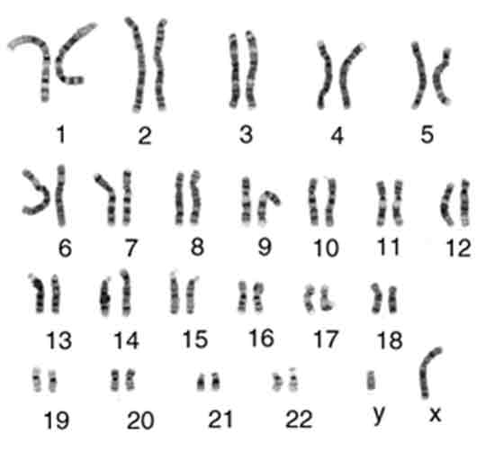

Slide 8
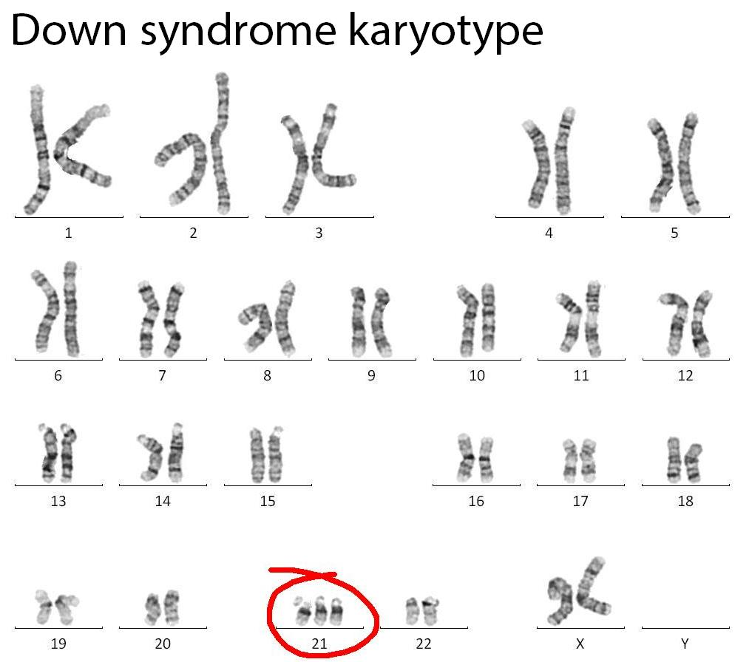

Slide 9
Chromosome Types
Sex chromosomes
Determine the sex
Female XX
Male XY
One pair (23rd chromosome)
Somatic chromosomes or Autosomes
22 pairs of homologous chromosomes
Exactly the same in males and females
Direct the organs and structure of the body
Y
X

Slide 10
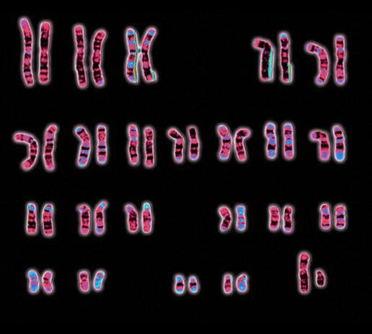
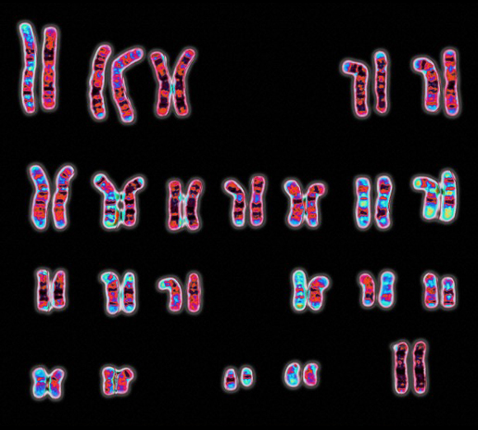
Male or Female?
X Y
X X

Slide 11
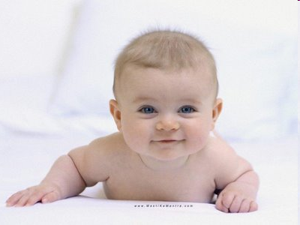
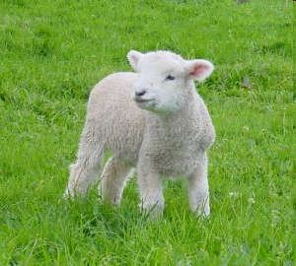
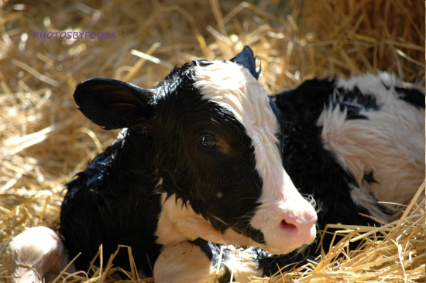
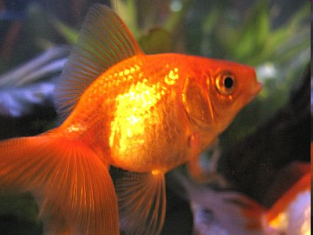
23 pairs of chromosomes
54 pairs of chromosomes
60 pairs of chromosomes
104 pairs of chromosomes

Slide 12
Number of Chromosomes
TABLE 3-1NUMBERS OF PAIRS OF CHROMOSOMES IN DIFFERENT SPECIES OF PLANTS AND ANIMALS
Common name | Number of chromosome pairs
Mosquito | 3
Housefly | 6
Toad | 11
Rice | 12
Frog | 13
Cat | 19
House mouse | 20
Human | 23
Cattle | 30
Donkey | 31
Horse | 32
Dog | 39
Chicken | 39
Carp | 52

Slide 13
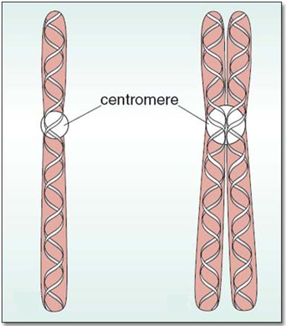
Chromosomes are replicated every time a cell replicates
Chromatid
Centromere
Duplicated chromosome (two identical strands of DNA)
When cell divides, each of the two new cells will receive one chromatid
Holds the two chromatids together until cell division
Where identical chromatids are most closely in contact

Slide 14
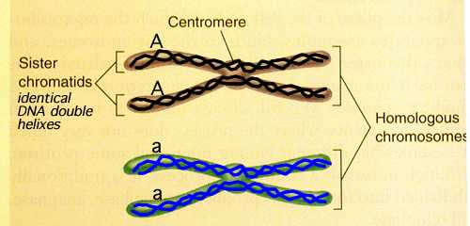

Slide 15
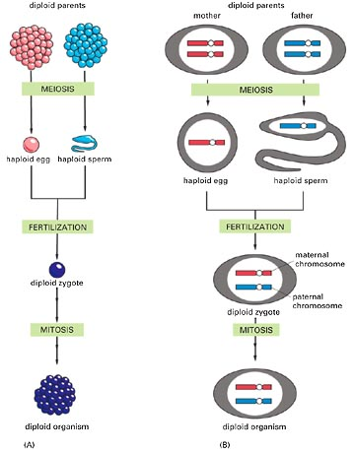
Important Vocabulary
NOT ALL CELLS CONTAIN THE SAME NUMBER OF CHROMOSOMES
Diploid: all somatic cells having two sets of chromosomes
2n
Haploid: sex cells (germ cells) containing only one set of chromosomes
Have half the number of chromosomes as a diploid cell
1n

Slide 16
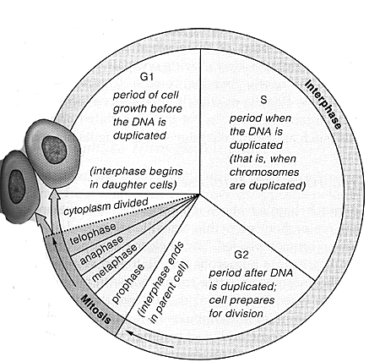
Cell Cycle of Eukaryotes

Slide 17
Interphase
The Different Phases…
G₁ | S | G₂ | G₀
First stage where cells grow to mature size; organelles duplicate | Chromosomes duplicate forming sister chromatids (Cell has 2x the amount of DNA it started with) | Cell grows & prepares for cell division (shortest phase) | Some cells stop maturing & enter this phase

