Slide 1
7 Characteristics of life

Slide 2
Characteristics of Life
Organization
Metabolism
Growth and Development
Homeostasis
Respond to the environment
Reproduction
Evolution

Slide 3
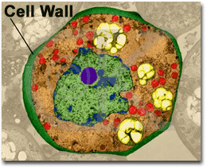
1. Organization
A cell is the smallest unit that can perform life’s functions
Unicellular- one cell in an organism (has everything it needs to be self-sufficient_
Multi-cellular- many cells in one organism (cells are specialized)

Slide 4
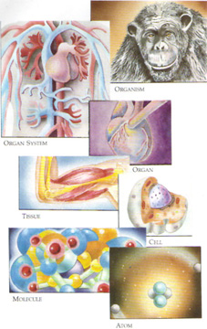
Cells→Tissues→Organs→Organ Systems
Notes:
Group with a common function

Slide 5
2. Metabolism
Energy flow is essential for living things.
Best explained through food web.
Metabolism-the process of acquiring energy through chemical reactions.
Autotrophs-organisms who can make their own food. (Ex. Plants)
(Anabolism - making of bonds.)
Heterotrophs-organisms who have to rely on other food sources. (Ex. Humans)
(Catabolism – breaking of bonds.)

Slide 6
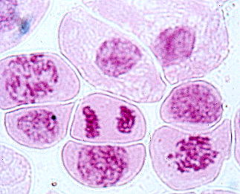
3. Growth and Development
Each organism has a distinct life cycle.
Growth occurs through cell division and cell enlargement.
Mitosis, meiosis, or binary fission.
Notes:
Cell division= new cells; cell enlargement

Slide 7
4. Homeostasis
The maintenance of a stable internal environment even though environmental conditions are constantly changing.
Give 2 examples and explain as it pertains to humans and sweating cannot be one of your choices ☺ (See what you can think of)

Slide 8
5. Respond to the Environment
Ecology- the study of how organisms interact with one another and with their environment.
This can be better studied by specifically observing organisms, populations, and communities.

Slide 9
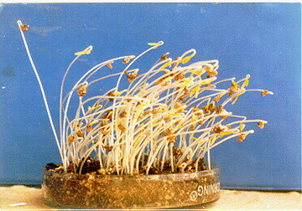
Respond to the Environment cont.
All organisms respond to the environment.
A response is a reaction from a stimulus.
Ie. If Sam smashes his hand in the car door, Sam may yell “Youch!”
A complex set of responses is called a behavior.
Ie. The annual migration of whales is a behavioral response to changes in the seasons.
Ie. Plants respond to light by growing towards it.

Slide 10
6. Reproduction
There are two basic kinds of reproduction:
Asexual reproduction- only one parent
Sexual reproduction- two parents are involved
All species of organisms have the ability to reproduce.
It is not essential for the survival of a single organism, BUT is essential for the continuity of life. No organism lives forever.

Slide 11
7. Evolution
Evolution- a change over time; helps us to understand how many kinds of organisms have survived or become extinct.
Natural Selection- According to this theory, organisms that have certain favorable traits are better able to reproduce than organisms that lack those traits.

